Slide 1
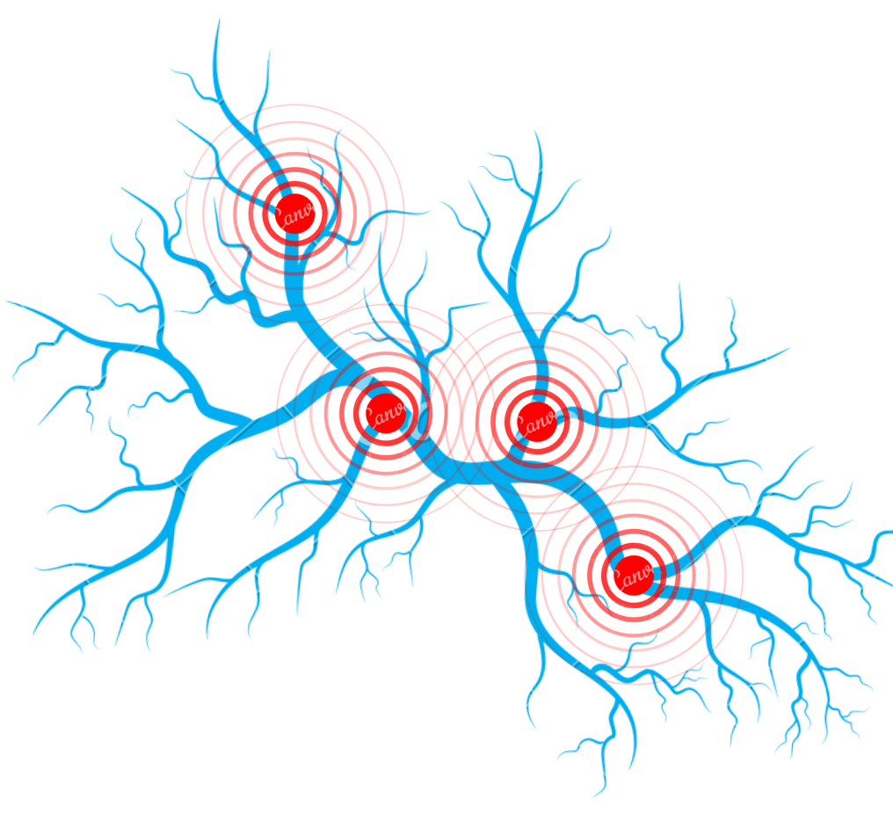
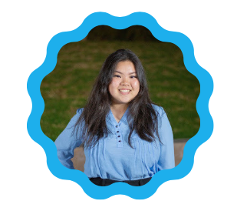
STOP THE CLOT
Blood Clot Awareness Preventative health education on the signs, symptoms, & importance.
Presented by Cindy Nguyen, Biology B.S.
Community Health Worker

Slide 2
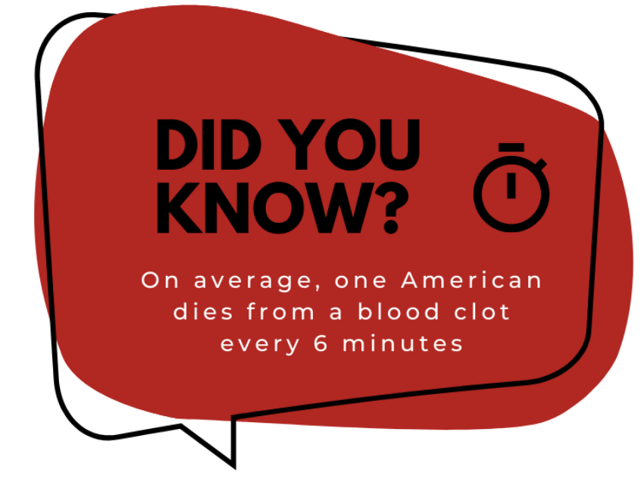
Background
Why Blood Clots?
Blood clots are a growing public health problem in the United States.
“100,000-300,000 deaths from blood clots occurs annually, higher than the annual deaths for AIDs, Breast Cancer, & Motor vehicle accidents COMBINED”(NBCA).
A blood clot often thought of as complication of another disease, however it is important to remember it can be an idiopathic disease, able to affect anyone.
Source: The National Blood Clot Alliance

Slide 3
Source: University of Bristol

Slide 4
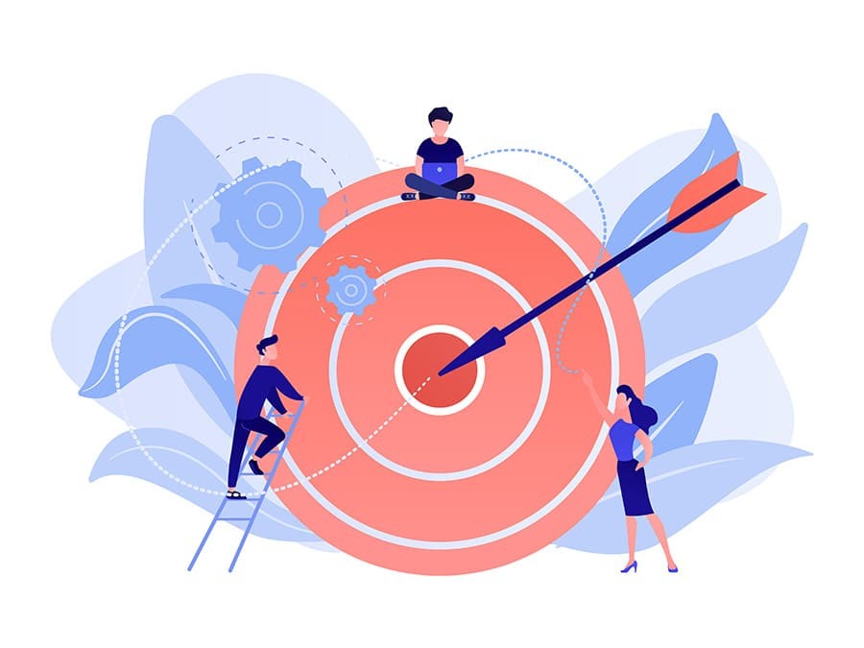
Project Objectives
The 3 Main Goals
Educate the Inland Empire community about blood clots!
Share ways to prevent blood clots & how to detect blood clots!
Increase knowledge on the available resources both in the Inland Empire area and virtual!

Slide 5
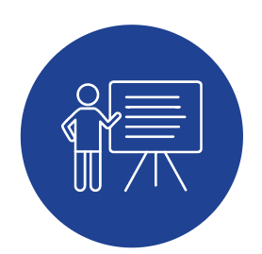
Methods & Outcomes
What Tools Were Used?
PRESENTATIONS
In-Person Presentation
3/13: 20 total participants
Zoom Presentations
4/03: 10 total participants
4/08: 13 total participants
43 Total Participants
38 Total Surveyed Participants

Slide 6
Methods & Outcomes
What Tools Were Used?
SOCIAL MEDIA
Instagram Story
4/28: 30 views & 20 likes
(+) 30 participants
(+) 4 surveys to the total
73 Total Participants
42 Total Surveyed Participants

Slide 7
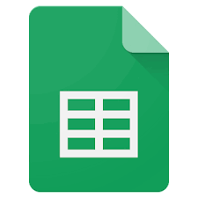
Methods & Outcomes
What Tools Were Used?
GOOGLE FORMS & GOOGLE SHEETS

Slide 8
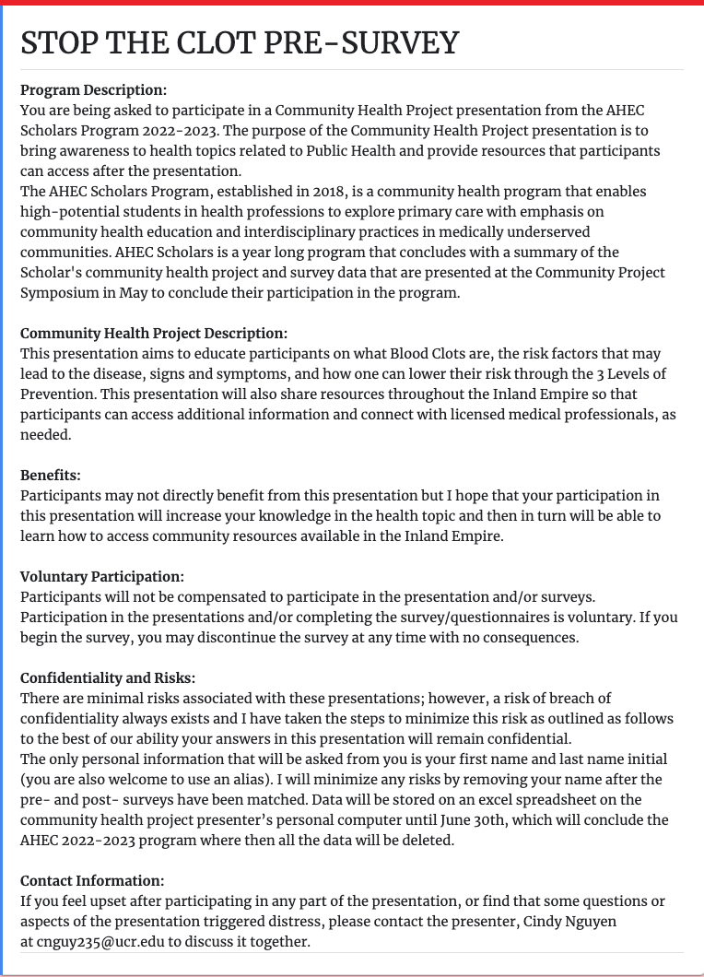
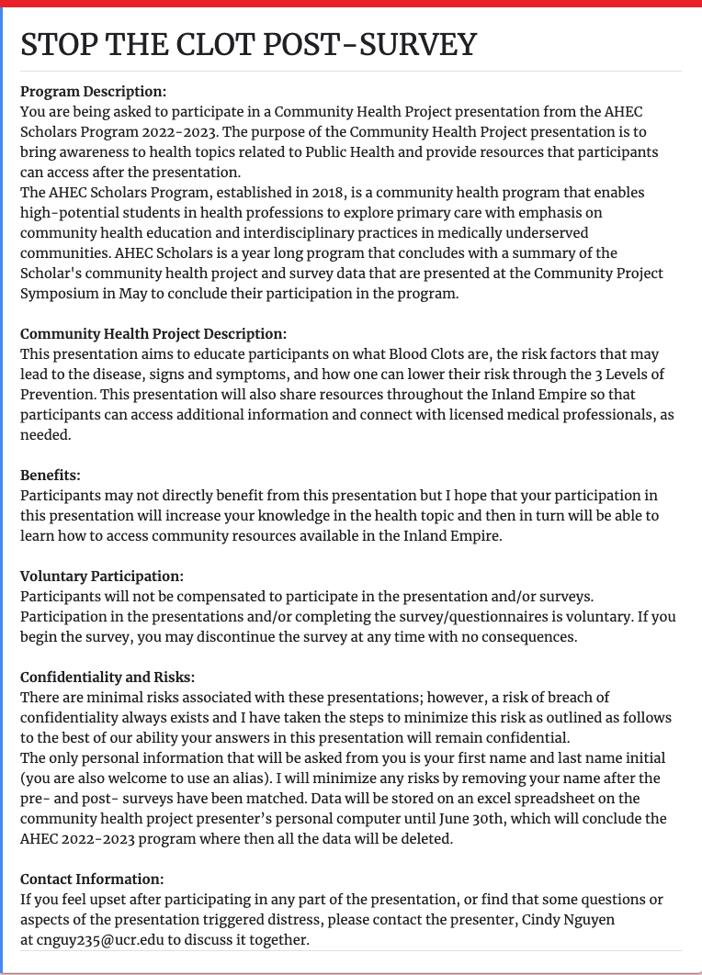
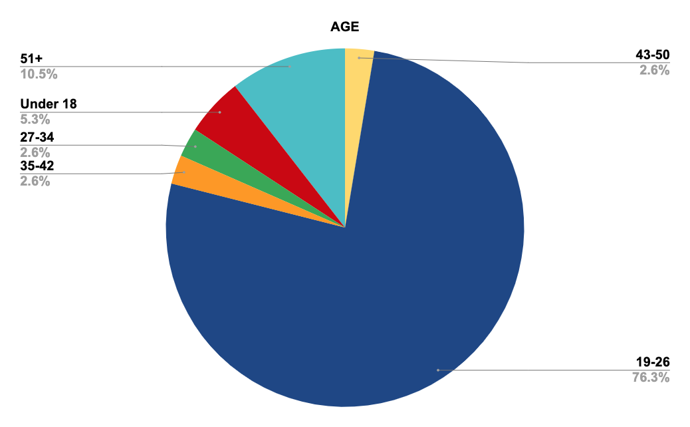
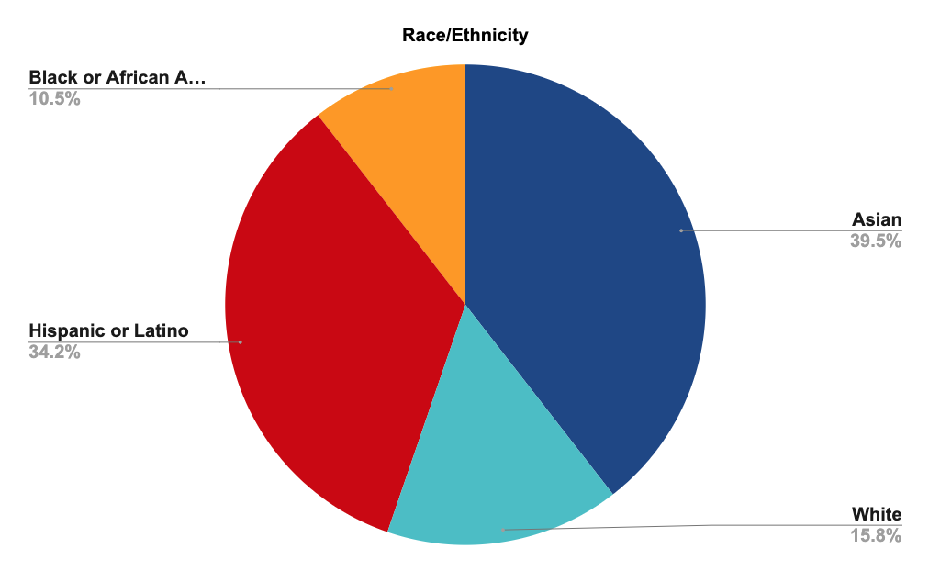
Results
The Surveys
42 participants completed the pre-survey
38 participants completed the post-survey
38 participants matched!

Slide 9
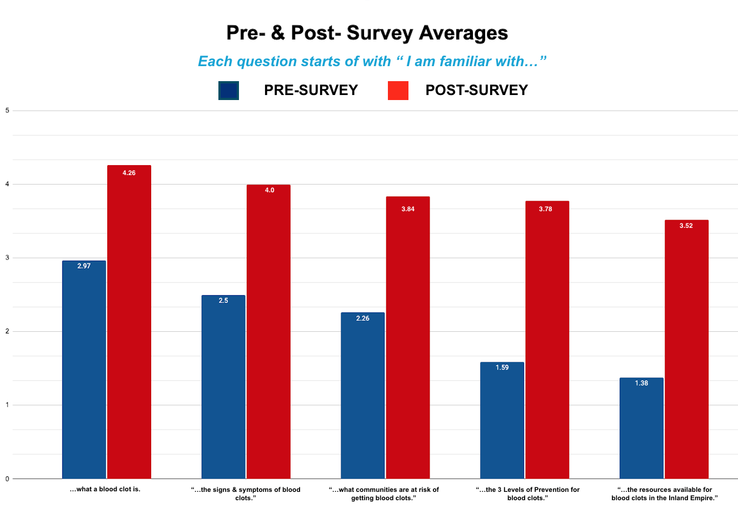
Results
The Surveys

Slide 10
Sustainability
Limitations
Future Research
Limited Time
1 month
More virtual than in-person presentation
Survey Integrity
73 total participants
42 participants completed both surveys
Outreach to more diverse audiences
Schools
Highschool--->College
Community Centers
Research more on the health disparities among races and sexes

Slide 11
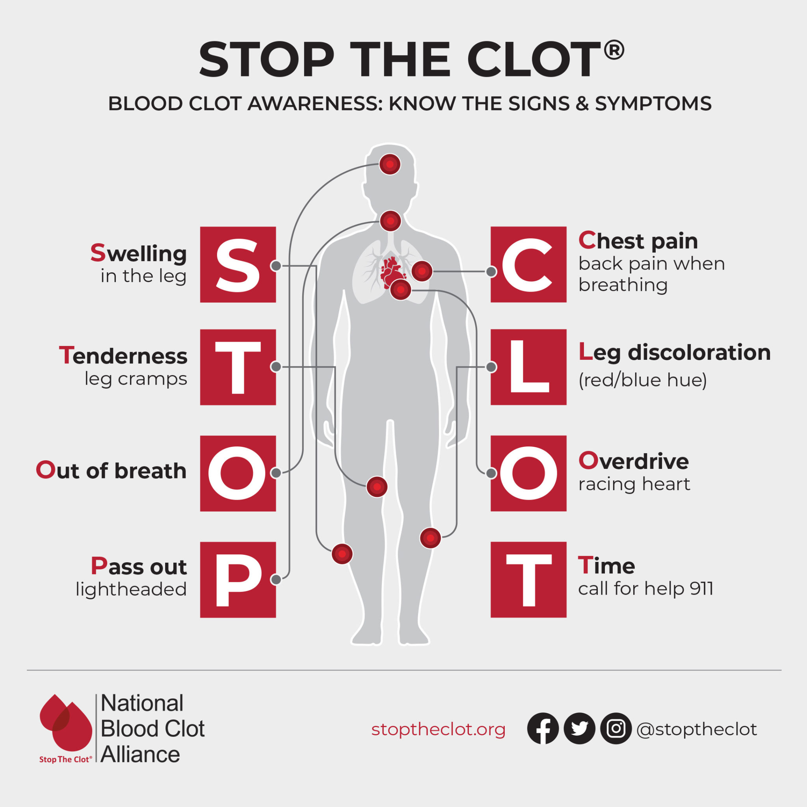
Learning Outcome
What did I personally learn?
Blood Clots are idiopathic!
Sign & Symptoms
The 3 Level of Prevention
More awareness and community education is needed

Slide 12
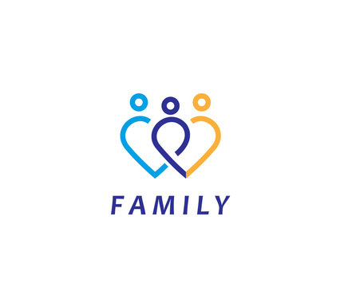
Acknowledgements

Slide 13
References
https://www.stoptheclot.org/about-clots/blood-clot-info/
https://www.bristol.ac.uk/news/2022/september/blood-clots-covid-19.html
https://my.clevelandclinic.org/health/diseases/17675-blood-clots
https://www.mayoclinic.org/symptoms/blood-clots/basics/definition/sym-20050850

Slide 14
Thank you! Question, Comments, Concerns?

