Slide 1
California’s Central Valley Physician Shortage:
An Inside Perspective
A.T. Still University - School of Osteopathic Medicine in Arizona
Central Valley AHEC Program
Esteban Rios, OMS-II
Rebekah Hwang, OMS-II

Slide 2
Background
The San Joaquin Valley (SJV) also called the “Central Valley” of California spans as far south as Bakersfield and as far north as Stockton (excluding the Sacramento Valley)
The SJV has the lowest doctor-per-capita ratio in California (170 for every 100,000 vs. 304)
Currently, there is no fully accredited medical school based in the SJV

Slide 3
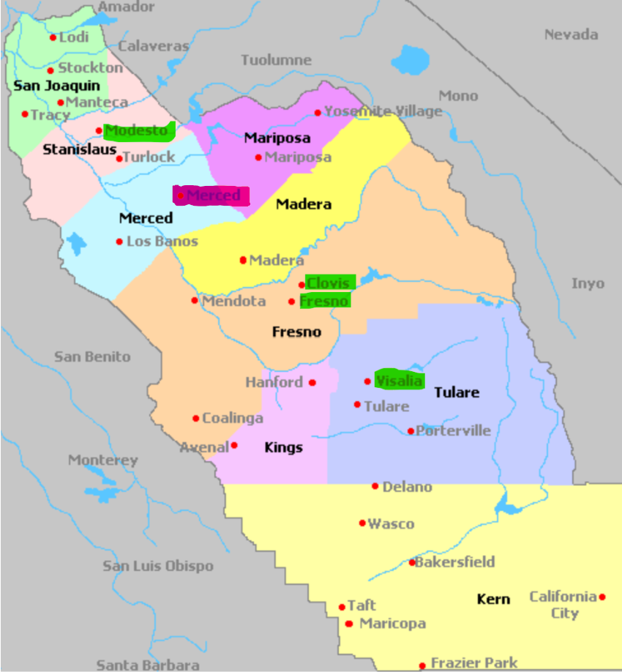
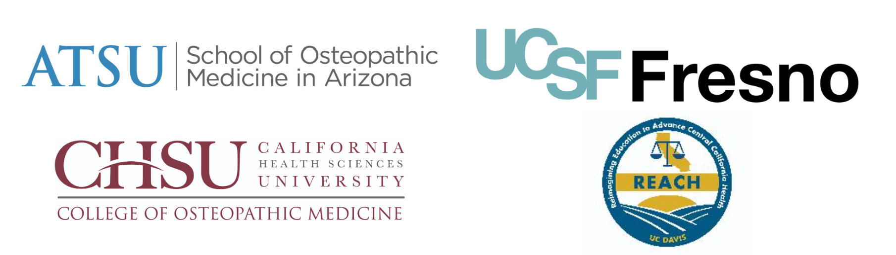
Objectives
Establish the Central Valley Medical Association (CVMA).
Organize first ever Central Valley Medical Conference
Survey medical students in SJV
Survey physicians in SJV
Notes:
Clarify CVMA

Slide 4
Methods
A 25-item survey was sent to 5 physician networks
Tulare & Kings Medical Society
Fresno & Madera Medical Society
Kern Medical Society
Central Valley Healthcare Network
Family Healthcare Network
A 18-item survey was distributed to medical students in each of the four medical student programs in the SJV.
A.T. Still University School of Osteopathic Medicine in Arizona (Visalia, CA)
UCSF San Joaquin Valley - Program in Medical Education (Fresno, CA)
UC Davis School Of Medicine - Reimagining Education to Advance Central California Health Program (Modesto, CA)
California Health Sciences University College of Osteopathic Medicine (Clovis, CA)
Participants were anonymously asked to identify factors that influenced their decisions to pursue and continue training/employment within the Central Valley.
The survey was shared via email, QR code link, and social media.
Notes:
PRIME and REACH

Slide 5
Demographics: Age, Sex, Race/Ethnicity
Physicians
92 participants
64% Male
44% White/Caucasian
Medical Students
33 participants
21% Male
36% Hispanic/Latino

Slide 6
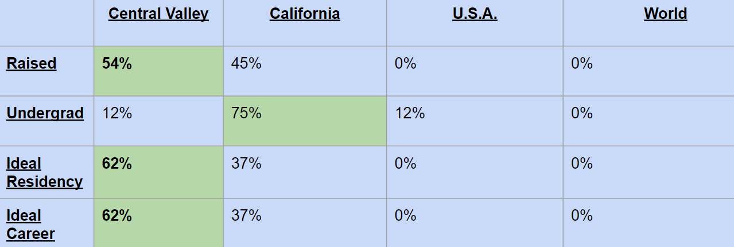
Demographics: Location
Physicians
Medical Students

Slide 7
Demographics: Other
Physicians:
Medical Students:
M.D. 90%
30% had over 31 years of serving
Majority are Internists (19%)
Osteopathic 78%
45% were 1st year medical students
45% were 3rd year medical students
10% were 4th year medical students

Slide 8
Results
Top reason to train/work in the Central Valley for both Medical Students & Physicians:
Desire/Mission to serve the underserved
Q: Why work in the Central Valley?
Least satisfying factor with working/training in the Central Valley:
Medical Students:
Quality of care patients receive
Physicians:
Organizational leadership
Lowest Likert score with identifying with one’s work in the Central Valley:
Medical Students:
“I rarely think about completing medical school elsewhere”
Physicians:
“I rarely think about looking for a job in another region”.

Slide 9
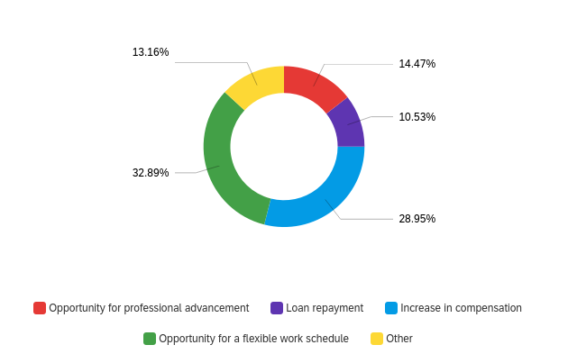
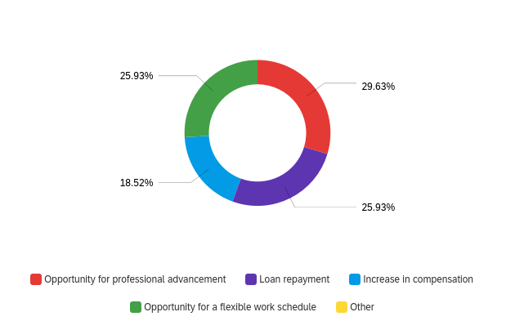
Results
Q: What could keep medical students & physicians in the Central Valley?
13.16%
14.47%
Physicians:
Other (13%)
Physician led hospitals
Like-minded practice partners
Ability to work after 70
Not applicable due to retirement
Medical Students:
Opportunity for professional advancements (~30%)
10.53%
32.89%
28.95%
25.93%
29.63%
18.52%
25.93%
Notes:
Make the numbers bigger

Slide 10
Results: General Statements
Q: What is the biggest issue in our community?
Physicians:
“I take my personal responsibility to patients seriously & have worked hard for my reputation. I am less satisfied with my practice, ability to achieve leadership roles, and overall respect from the healthcare community”
“I love being in an area of more autonomy and less litigation for physicians to work in”
“I am so proud to be helping the Hispanics but i am so sad that Medical care has dehumanized them and made them Insurance cards and numbers only”
Medical Students:
“Lack of consistency in physicians. Especially in primary care programs, it’s important for there to be longitudinal relationship between physicians and their patients”
“Shortage of physicians and lack of preventative care and education within the community that are results of social determinants of health”
“Lack of access to care in rural areas especially for immigrant farm worker populations”
Notes:
Just emphasize what’s bolded

Slide 11
Results
What are physicians and medical students looking for support in?
Physicians:
“Continue to work for increased funding and fight administrative burden, provide CME and wellness programs such as the ones they already provide. Advocate for justice through equity, diversity and inclusion within the practice of medicine”.
“Encourage younger physicians to buy homes and settle down here”
“Update and hone the focus of its mission and ensure that new physicians to the area get some sort of orientation about the specific benefits of enrollment. I could still use an orientation to all the benefits that have been previously offered so I could better image what the benefits have been over the years”.
Medical Students:
“More hands on experience”
“Networking opportunities”
“Provide residency opportunities, medical student opportunities to get involved”
“Scholarships”
“I’m hoping this association will help me with networking to provide both educational and career opportunities to better serve the community”

Slide 12
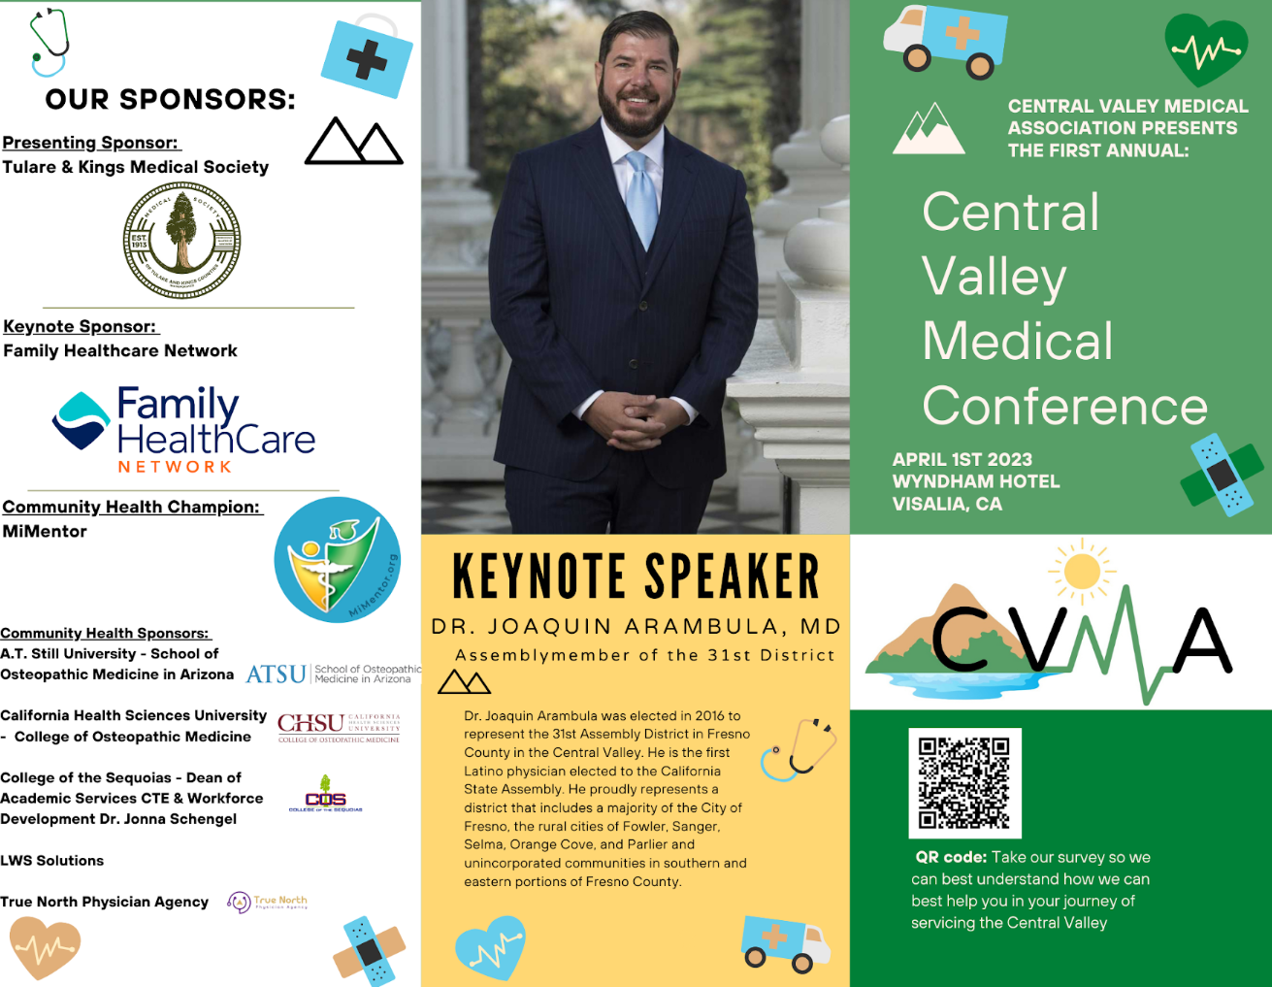
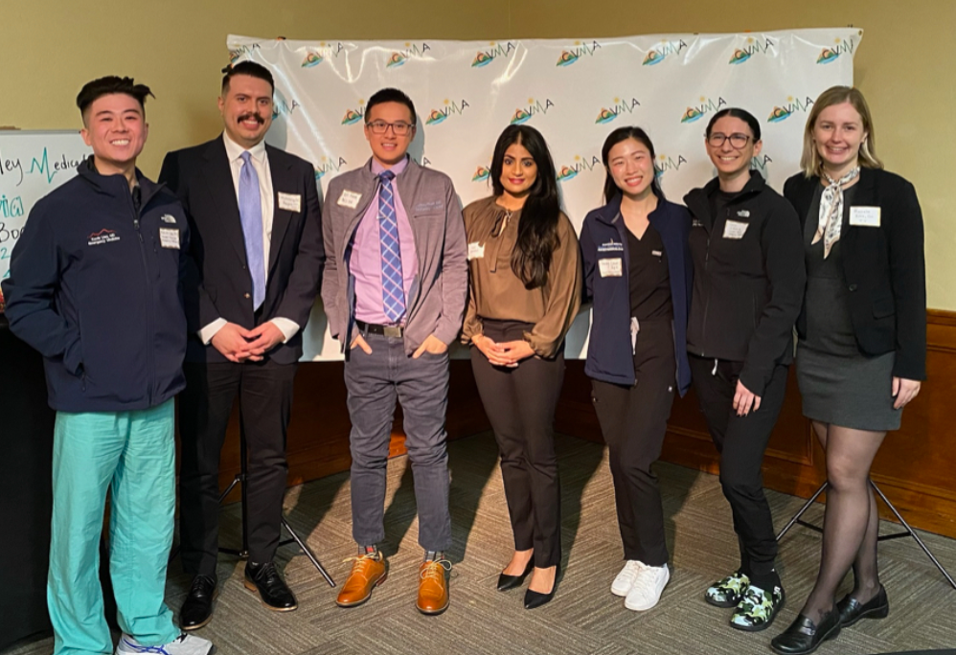
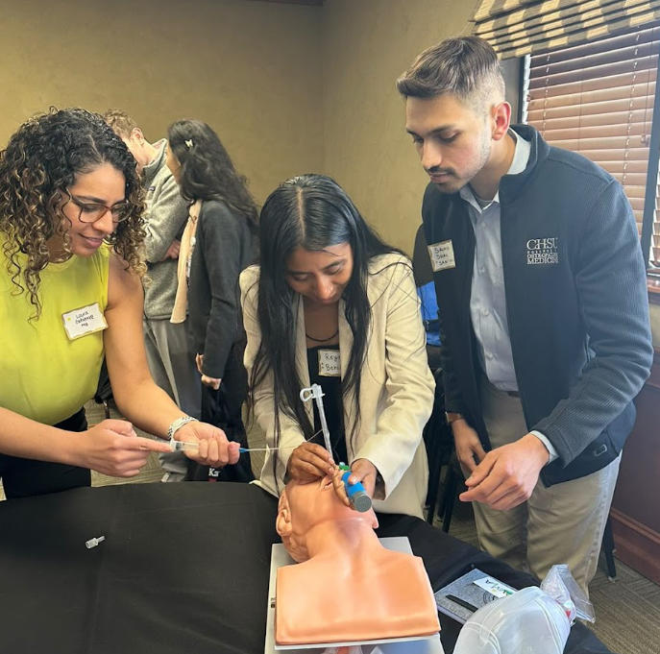
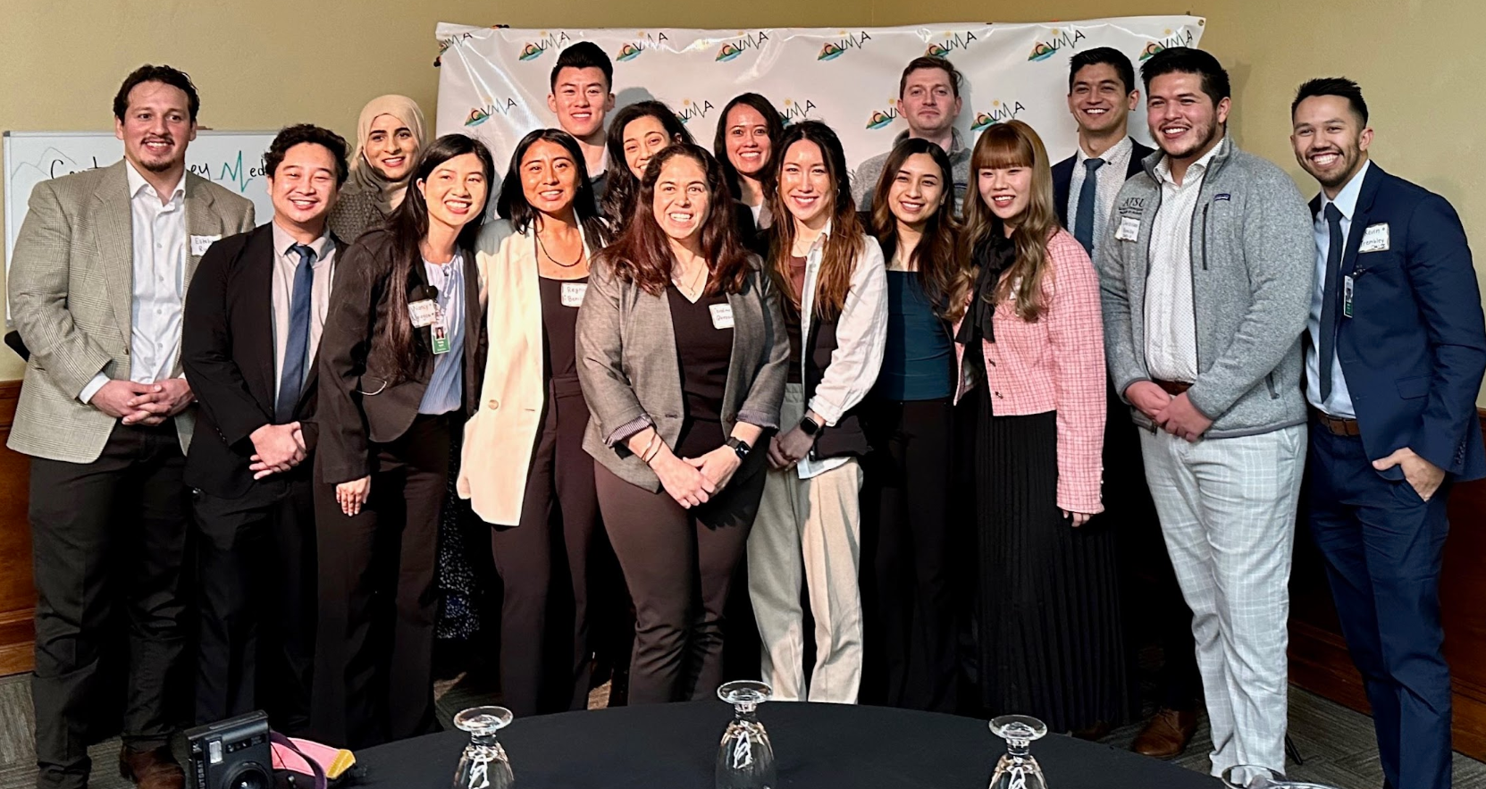

Slide 13
Conclusion and Next Steps
Medical student to physician pipeline
2nd annual Central Valley Medical Conference
Meeting: July 1st, 2023 Zoom
Community engagement
Follow us on social media:
Instagram: @ca_cvma
LinkedIn: Central Valley Medical Association
Volunteer events: Health screening
Diversity
Celebrating women in medicine
Increasing mentorship opportunities
Physician Advocacy

