Slide 1
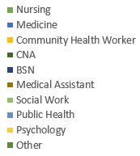
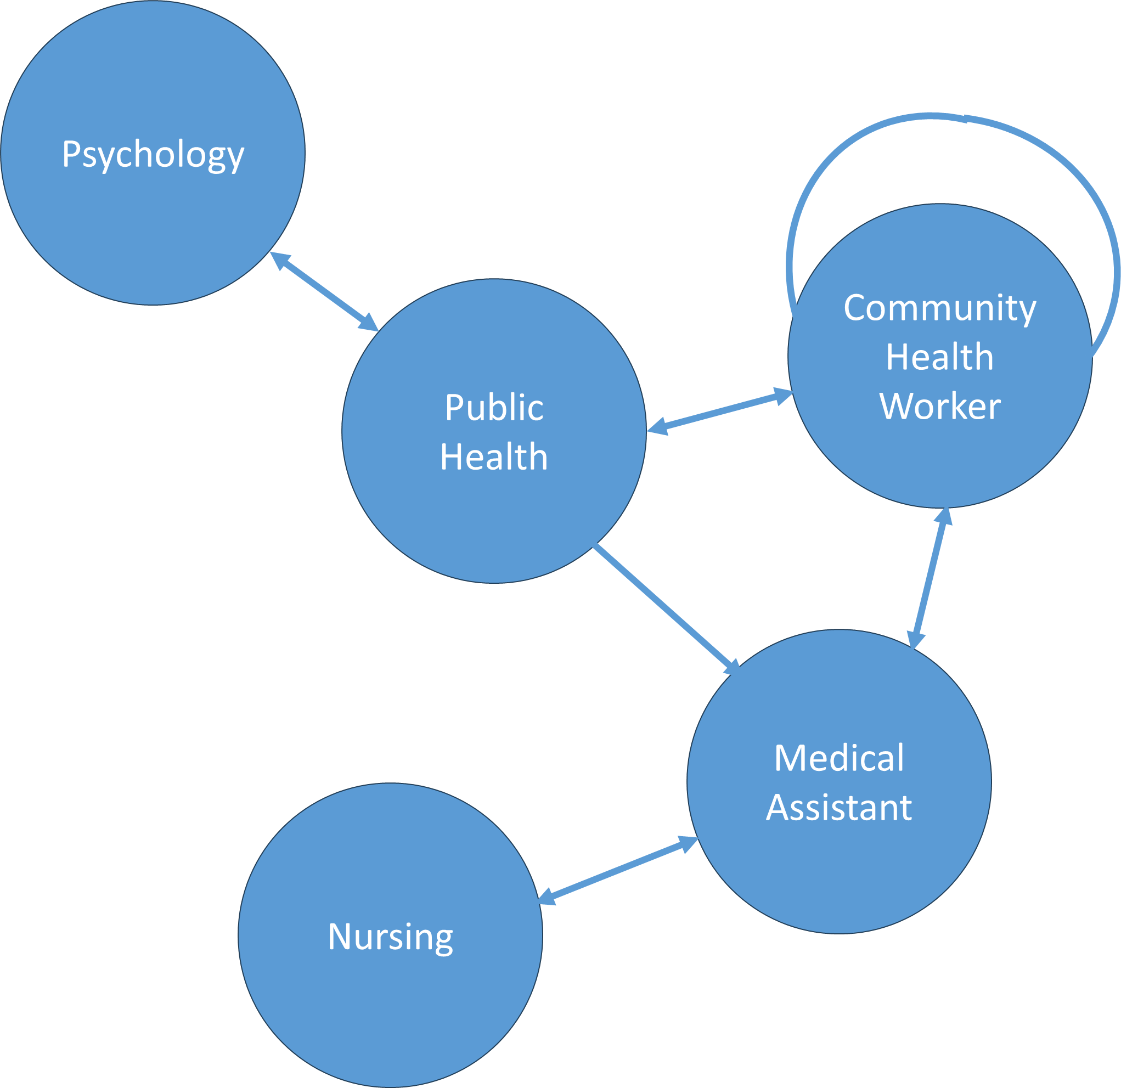
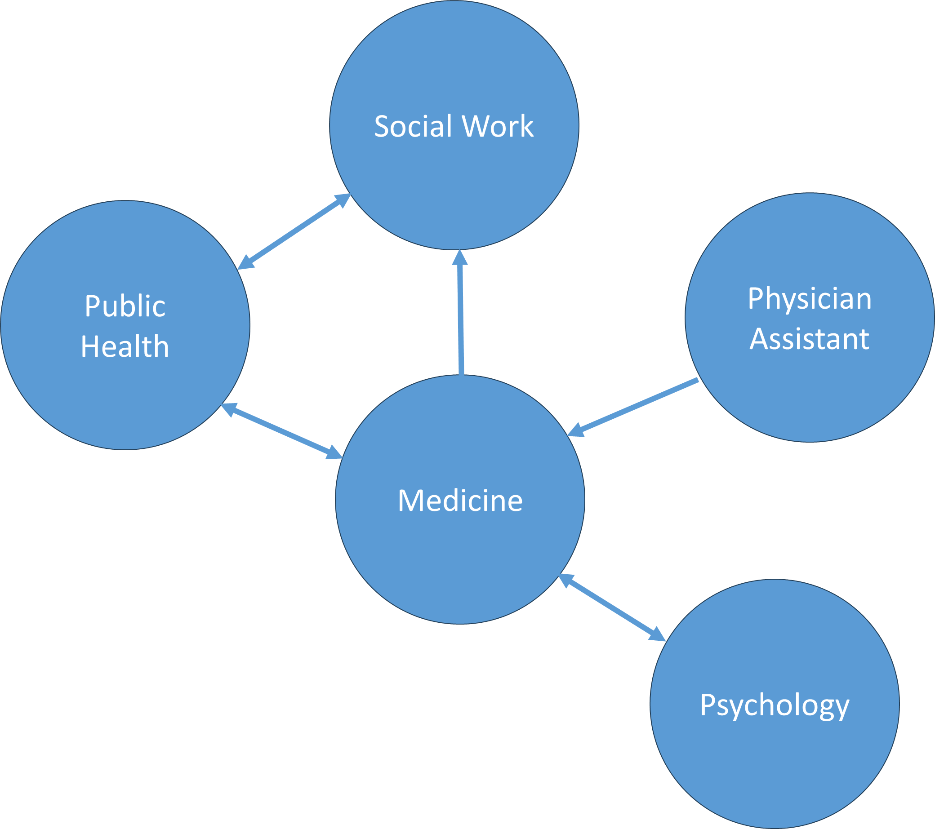
Enhancing Interactivity in an Asynchronous Online Curriculum for a Diverse Health Professions Education Program
Iris Price ^{1,2,} Shelby Fallas ^{1,2,} Virginia Fowkes ^{1,3}, Juan Garza, MA^{1,2}, Ivan Gomez, MD ^{1,2}
¹California Area Health Education Center (AHEC), ²UCSF Fresno, ³Stanford University
Introduction
AHEC Scholars
Analysis
Critical reflection deepens learning by connecting theory and practice, fostering meaningful educational experiences.
The California AHEC Scholars program provides a comprehensive education in community health, incorporating web-based didactics, clinical training, and hands-on activities.
We examined the impact of moving from individual to interactive critical reflection methods, specifically transitioning from module-based reflections to discussion boards, enabling peer engagement in the reflection process.
Student Interaction Networks
1-Year Scholars
2-Year Scholars
Methods
1-Year Scholars | 2-Year Scholars
Community Health Worker | Nursing
Behavioral Health | Dentistry
Medical Assistant | Medicine
Psychology | Physician Assistant
Public Health | Public Health
Social Work | Social Work
 | Psychology
Discussion boards were introduced in September 2023 to increase the sense of connectedness among the scholars and allow them to participate in critical reflection with scholars from different disciplines.
Scholars complete a 1-year or 2-year curriculum based on their discipline.
There are a total of 133 scholars for 2023-2024.
Students completed an initial post and responded to two posts by other scholars.
Measured interactivity between scholars and compared qualitative responses between discussion boards and individual reflections.
Aspect | Individual Reflections | Discussion Posts
Depth of Reflection | High - Personal insights and detailed exploration of topics | Varied - Depth depends on engagement level and interaction
Engagement | Low - Isolated reflections without peer interaction | High - Active engagement through replies and discussions
Diversity | Low - Singular perspective | High - Multiple perspectives due to interdisciplinary interaction
Critical Thinking | Varied - Depends on individual’s analytical skills | Higher - Encouraged by peer questions and comments
Learning Outcomes | Self-directed insights | Collaborative learning through interaction
Module Topics
Community Engagement | Patient-Centered Medical Home
Health Care Reform | Quality Improvement
Leadership and Advocacy | Team-Base Care
Medical Neighborhood | Work-life Balance
Patient Engagement
This work was supported by the Health Resources Services Administration, Grant # U77HP23071

