Slide 1
California Statewide AHEC Burnout Prevention and Resiliency Program
Ivan Gomez, MD, FAAFP, Virginia Fowkes, FNP, MHS, Iris Price, MA, Juan Garza, MA, Mark Linzer, MD, MACP, Catherine Justice, DPT, C-IAYT, FAIHM

Slide 2
Disclosures
We have no actual or potential conflict of interest in relation to this program/presentation.

Slide 3
Notes:
Poll Title: Do not modify the notes in this section to avoid tampering with the Poll Everywhere activity. More info at polleverywhere.com/support What is your role? https://www.polleverywhere.com/multiple_choice_polls/AvudZSH9fFz9pquGuPVdj?state=opened&flow=Default&onscreen=persist

Slide 4
Notes:
Poll Title: Do not modify the notes in this section to avoid tampering with the Poll Everywhere activity. More info at polleverywhere.com/support How are you feeling today? https://www.polleverywhere.com/free_text_polls/Ub5OdMsn6vq8P6E5R1ZCq

Slide 5
Notes:
Poll Title: Do not modify the notes in this section to avoid tampering with the Poll Everywhere activity. More info at polleverywhere.com/support Do you currently have a program at your institution for burnout prevention or resiliency program? https://www.polleverywhere.com/multiple_choice_polls/ertgZrw9hkkhUUPOrUP7A?state=opened&flow=Default&onscreen=persist

Slide 6
Introduction
Burnout is a national problem affecting the healthcare workforce and health professions students
Worsened with heightened demands from the 2022-2023 confluence of RSV, influenza, and COVID infections
Resources are needed to address burnout and increase resiliency

Slide 7
Background
Program inception, fall 2022
Part of AHEC Strategic Plan
Partnership with Institute for Professional Worklife, Hennepin Healthcare, University of Minnesota
Purpose: Prevent or mitigate burnout and moral injury

Slide 8
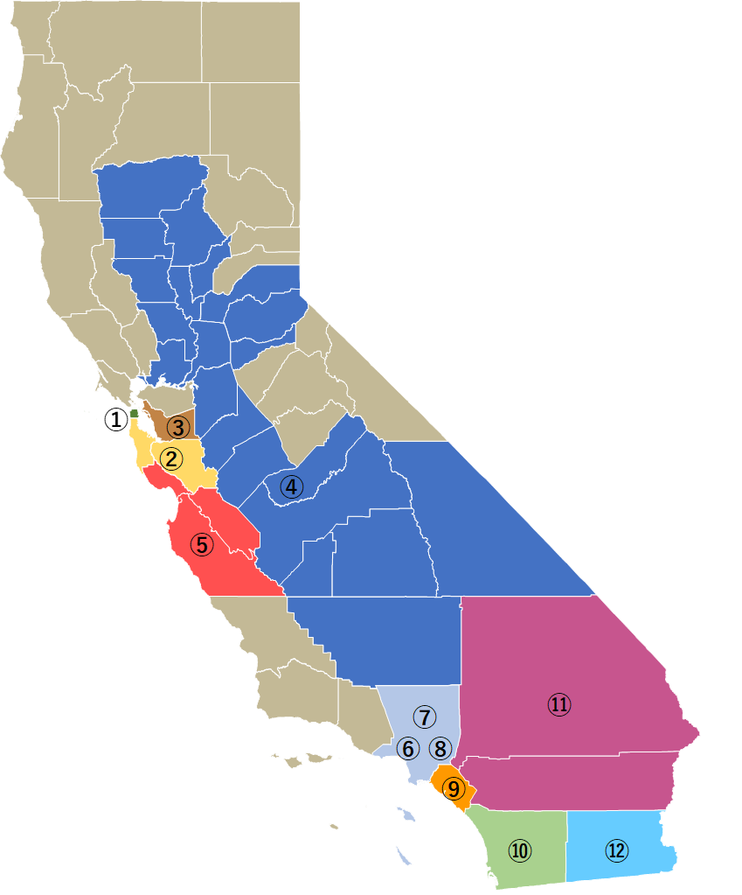
California AHEC sites

Slide 9
AHEC Cohorts for Trainings and Resources
Health professions students, AHEC Scholars
Family medicine residents
Practicing health professionals in CHCs/other underserved sites
Trainers

Slide 10
Methods
IRB-approved exempt study
Survey distributed by the Center Directors via email
Reminder to complete the survey
Respondents were invited to provide their email to received direct access to the resources

Slide 11
Mini Z Burnout Assessment
The 10-item, validated survey tool
Measures healthcare worker stress, satisfaction, burnout and the drivers of those outcomes
Includes satisfaction, stress, burnout, work control, chaos (work atmosphere), teamwork, values alignment
Additional questions that explore workplace autonomy and support

Slide 12
Types of Respondents
N = 417

Slide 13
Demographics - Gender
N = 417

Slide 14
Demographics – Race
N = 417

Slide 15
Demographics – Latino/Latinx/Hispanic
N = 417

Slide 16
Mini Z Results – Positive Attributes
N = 417

Slide 17
Mini Z Results – Negative Attributes
N = 417

Slide 18
Mini Z Results – Administrative and Clinical Autonomy and Support
N = 349

Slide 19
Mini Z Results – HP students Autonomy and Support
N = 68

Slide 20
Mini Z Results – Reported Burnout
N = 198
N = 151
N = 68

Slide 21
Notes:
Poll Title: Do not modify the notes in this section to avoid tampering with the Poll Everywhere activity. More info at polleverywhere.com/support Using your own definition of "burnout", please select one of the answers below: https://www.polleverywhere.com/multiple_choice_polls/Ov1e14JfK4SO1MrPPQkI1?state=opened&flow=Default&onscreen=persist

Slide 22
Mini Z Results – Burnout by Respondent Type
1 = low burnout; 5 = high burnout
N = 68
N = 151
N = 198

Slide 23
Mini Z Results – Additional Measures
Few participants reported experiencing gender (7%) or racial discrimination (2%)
62% of participants reported that they were likely to leave their job within 2 years

Slide 24
Training Modules

Slide 25
Training Modules
Each module has an introductory video
Other resources consist of written, audio, and video
Modules are hosted on Moodle and are available on demand
Modules 1-3 are completed, 4-6 in development

Slide 26
Example – Module 1 Contents
Videos
Introduction
Seated yoga
Belly breathing
MP3
Mindful awareness guided meditation
PDFs
Accounta-buddy
Gratitude
Exercise: Belly breathing yoga

Slide 27
Resources Developed as of June 2023
Resource list update quarterly: includes articles, books, podcasts, videos
Webinar: Basics of Burnout
Six Part Curriculum (modules 1-3 completed)
Plans to train the trainers
Targeted presentations: Central Valley AHEC CMOs
UCSF Fresno Faculty Medical Group

Slide 28
Lesson Learned
IRB approval process took longer than expected
Unanticipated distribution issue
Survey rollout was staggered

Slide 29
Family Medicine Residency Collaborative
4 Family Medicine Residency Programs are partnered with AHECs
UCLA, Scripps, Alta Med, and UCSF Fresno
Quarterly meetings to engage in discussion
Share resources
Problem solve
Deploy project resources

Slide 30
Future Directions
Provide each center with a personalized report of the survey results
Schedule a meeting in early July to meet with Center Directors and review the findings
Open Moodle to survey participants
Collaborate with Institute for Professional Worklife/Hennepin Healthcare to address specific needs of the centers
Send one-year follow-up Mini Z survey
Send end-of-year survey to assess perceptions of the curriculum and usage

Slide 31
Acknowledgements
Funding
Health Resources Services Administration, Grant # U77HP23071
California Department of Health Care Access and Information, State Office of Rural Health
Our collaborators at the Institute for Professional Worklife, Hennepin Healthcare

Slide 32
Questions?

