Slide 1
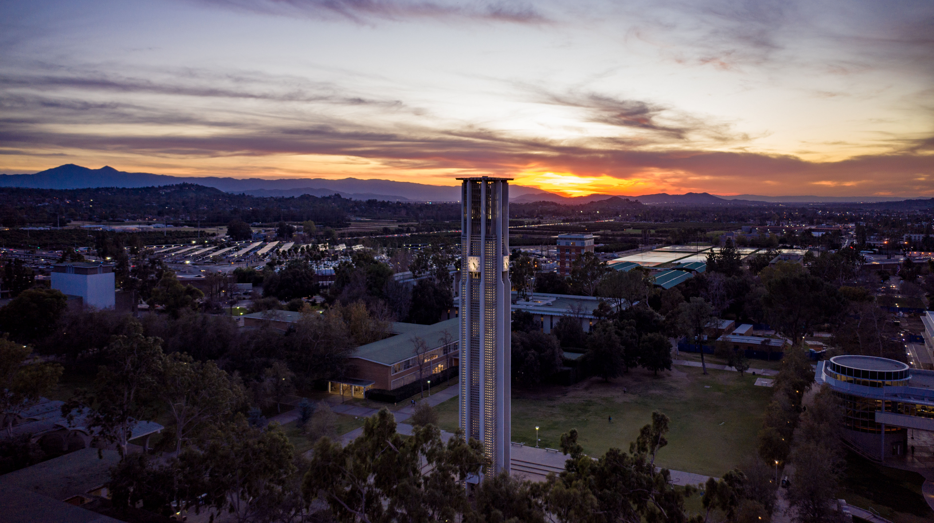


Jesus E. Toro
3rd Year Medical Student

Slide 2
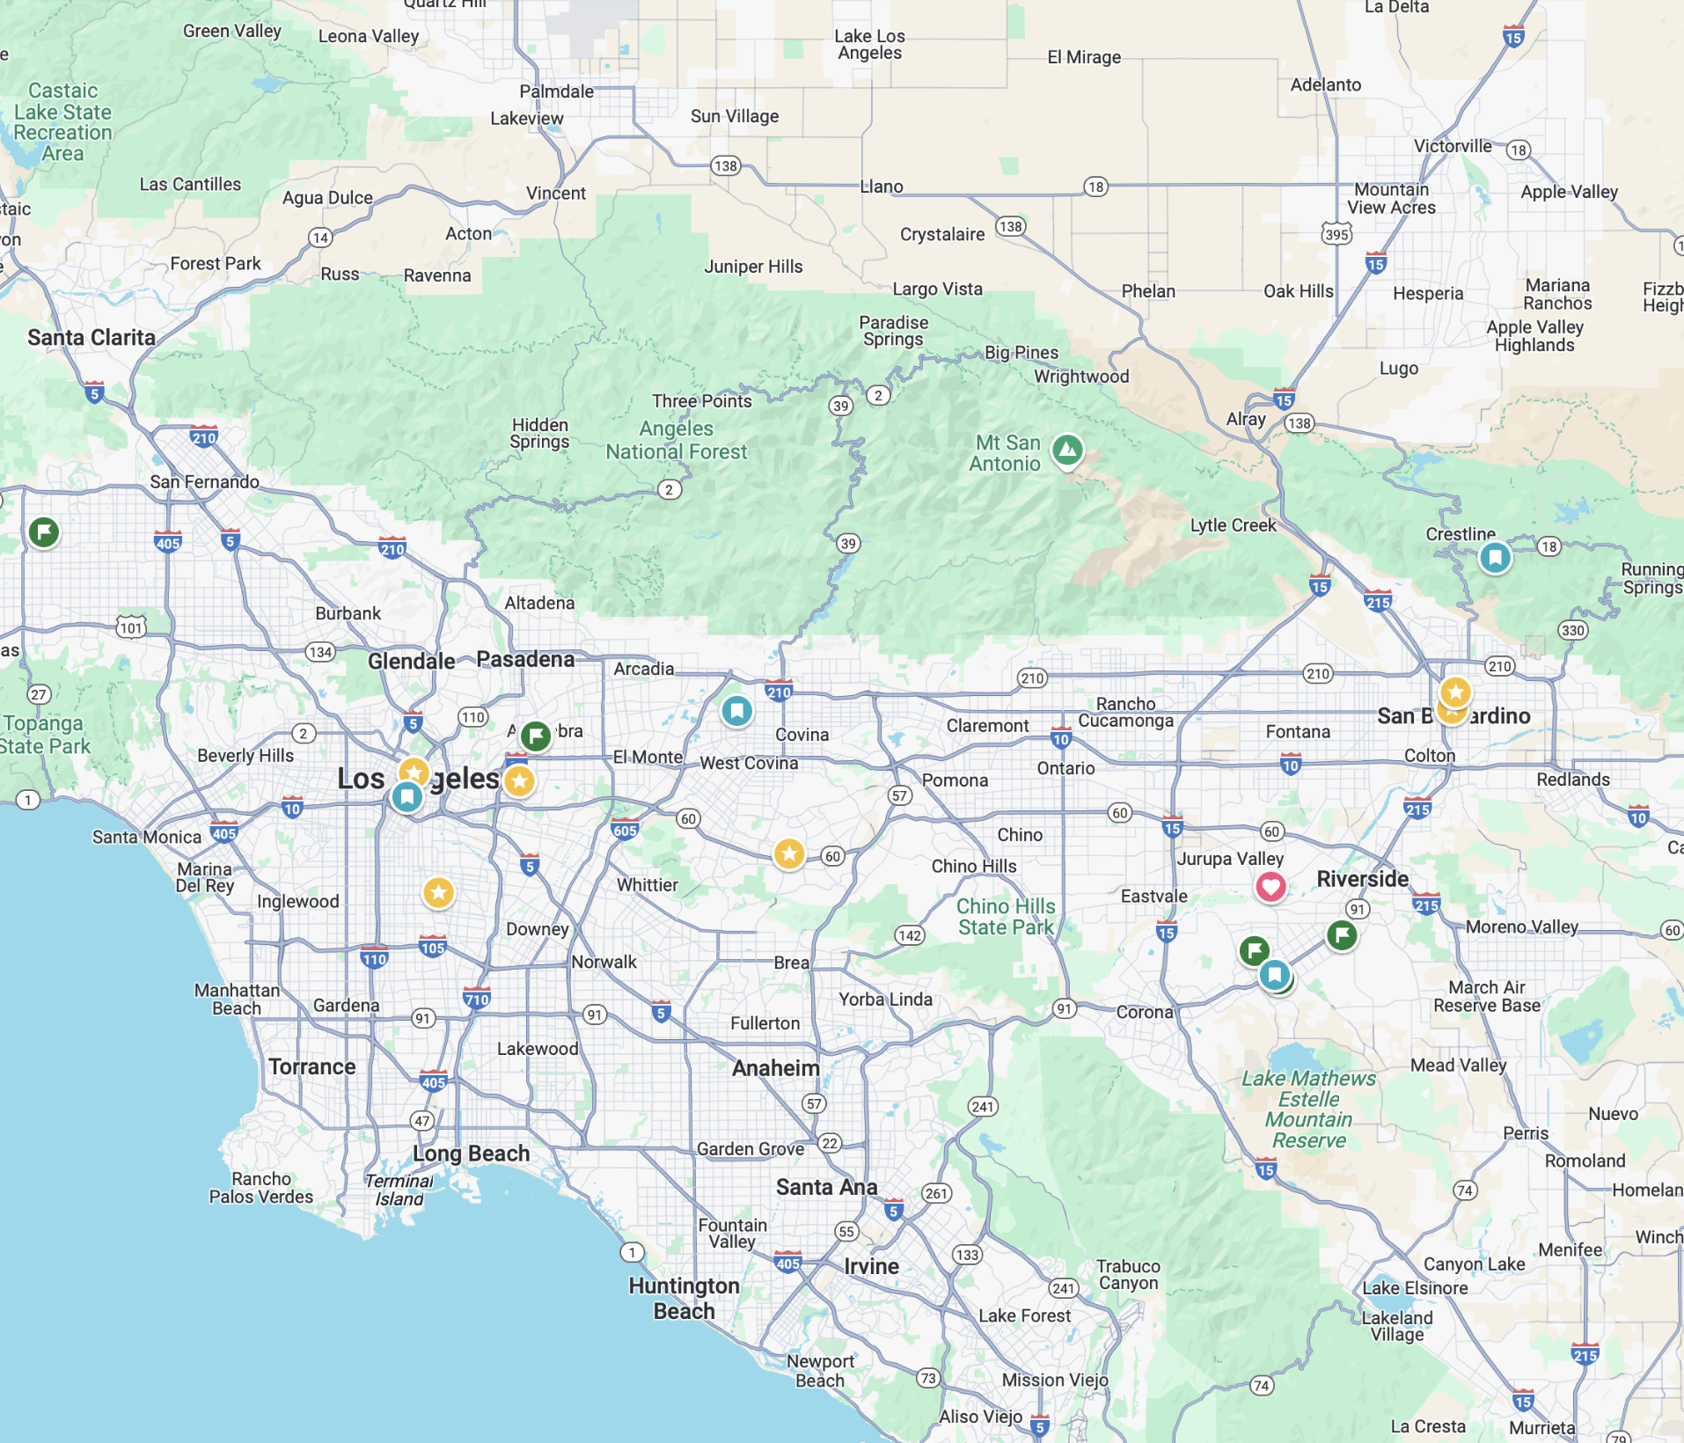
Background
SOUTHERN CALIFORNIA WOUND CARE:
OMNI WOUND PHYSICIANS
MISSION VIEJO > APPLE VALLEY > RANCHO PALOS VERDES
SOCIAL DETERMINANTS OF HEALTH
THAT “ONE PATIENT”
SURPLUS OF CLEAN, UNUSED SUPLIES – WASTED
CONTRIBUTIONS TOWARDS NARROWING THE GAP

Slide 3
Objectives
🩹 INCREASE ACCESS TO WOUND CARE SUPPLIES
🤲 SUPPORT CONTINUITY OF CARE FOR BED-BOUND OR RECENTLY DISCHARGED PATIENTS (i.e., HOSPITALS, CLINICS, OR HOSPICE
🏗️ BUILD SUSTAINABLE PARTNERSHIPS WITH FREE CLINICS AND LOCAL ORGANIZATIONS
👥 TAP INTO COMMUNITY COMPASSION TO ADDRESS POOR ACCESS TO COMPASSIONATE END-OF-LIFE CARE

Slide 4
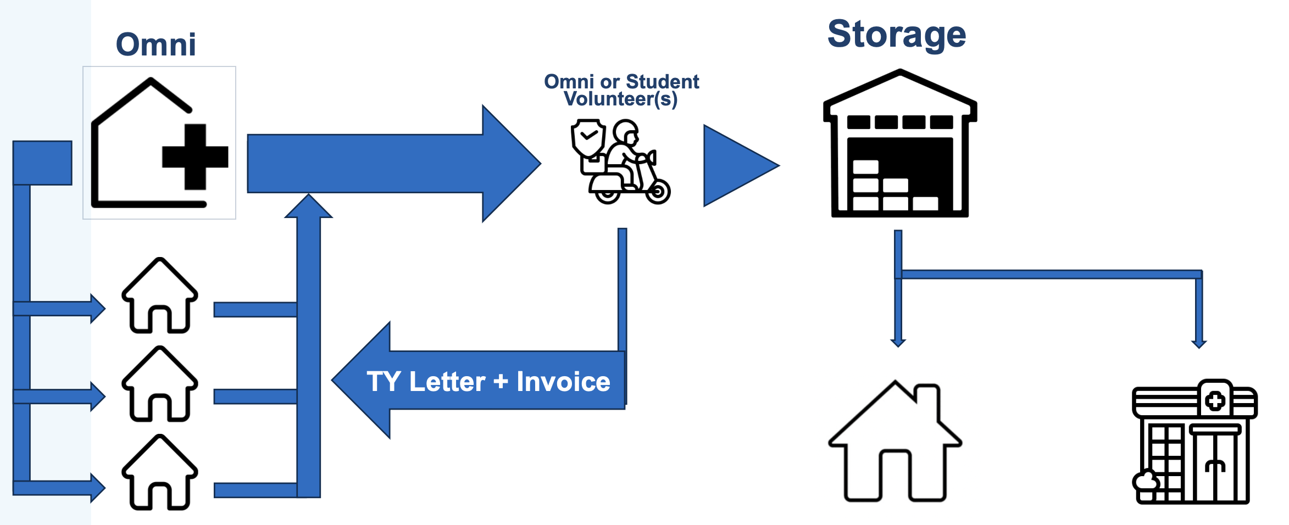
Methods
SUPPLIES COLLECTED FROM…
🧑‍🤝‍🧑 DONATING FAMILIES
🏥 WOUND CARE CLINICS/PRIVATE COMPANIES
- OMNI Wound Physicians
THEN REDISTRIBUTED TO…
FREE CLINICS
DIRECT DELIVERY TO PATIENTS*

Slide 5
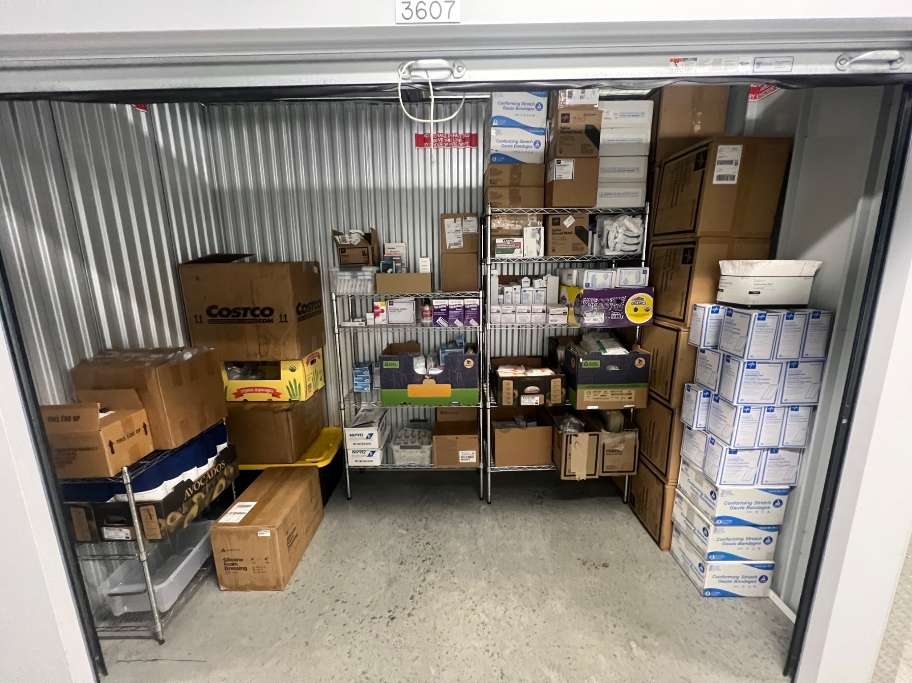
Milestones
PATIENT DONATIONS: ~$2600
OMNI DONATIONS TO DATE: ~$5,000
OTHER PRIVATE DONATIONS: ~$1,000
UCR SOM SUMMER SERVICE SCHOLARSHIP: $3,000
DEDICATED CLIMATE-CONTROLLED STORAGE UNIT (RIVERSIDE)
SURVEY-BASED SUPPLY REQUEST SYSTEM
Inventory as of January 6, 2025

Slide 6
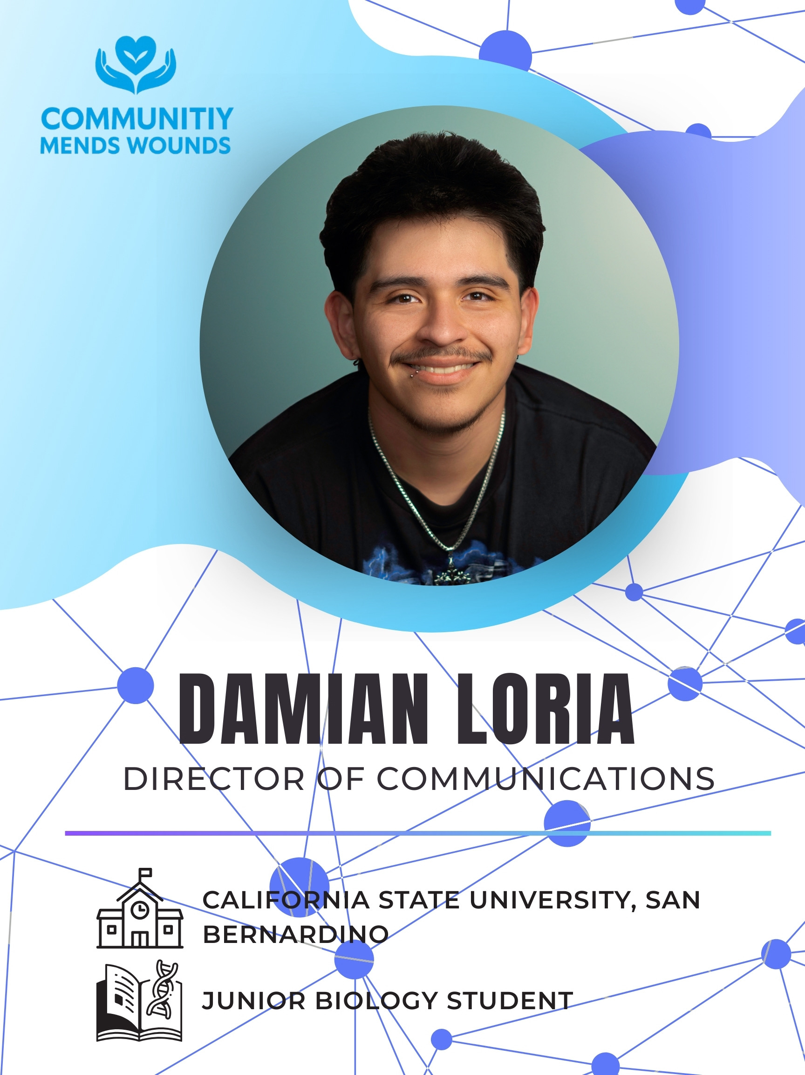
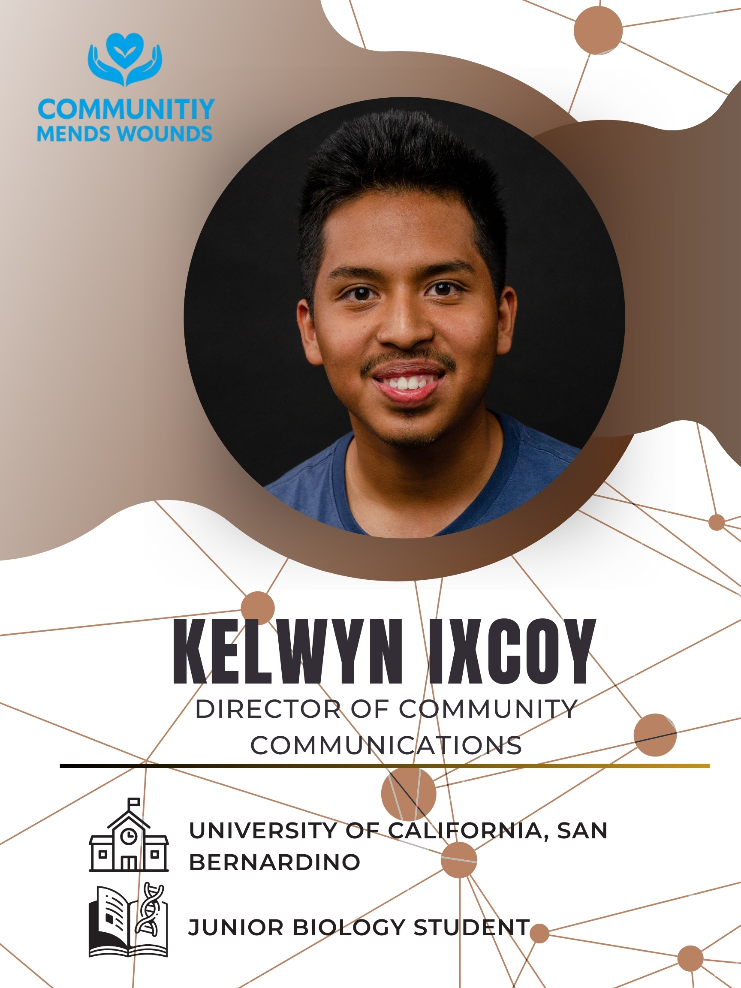
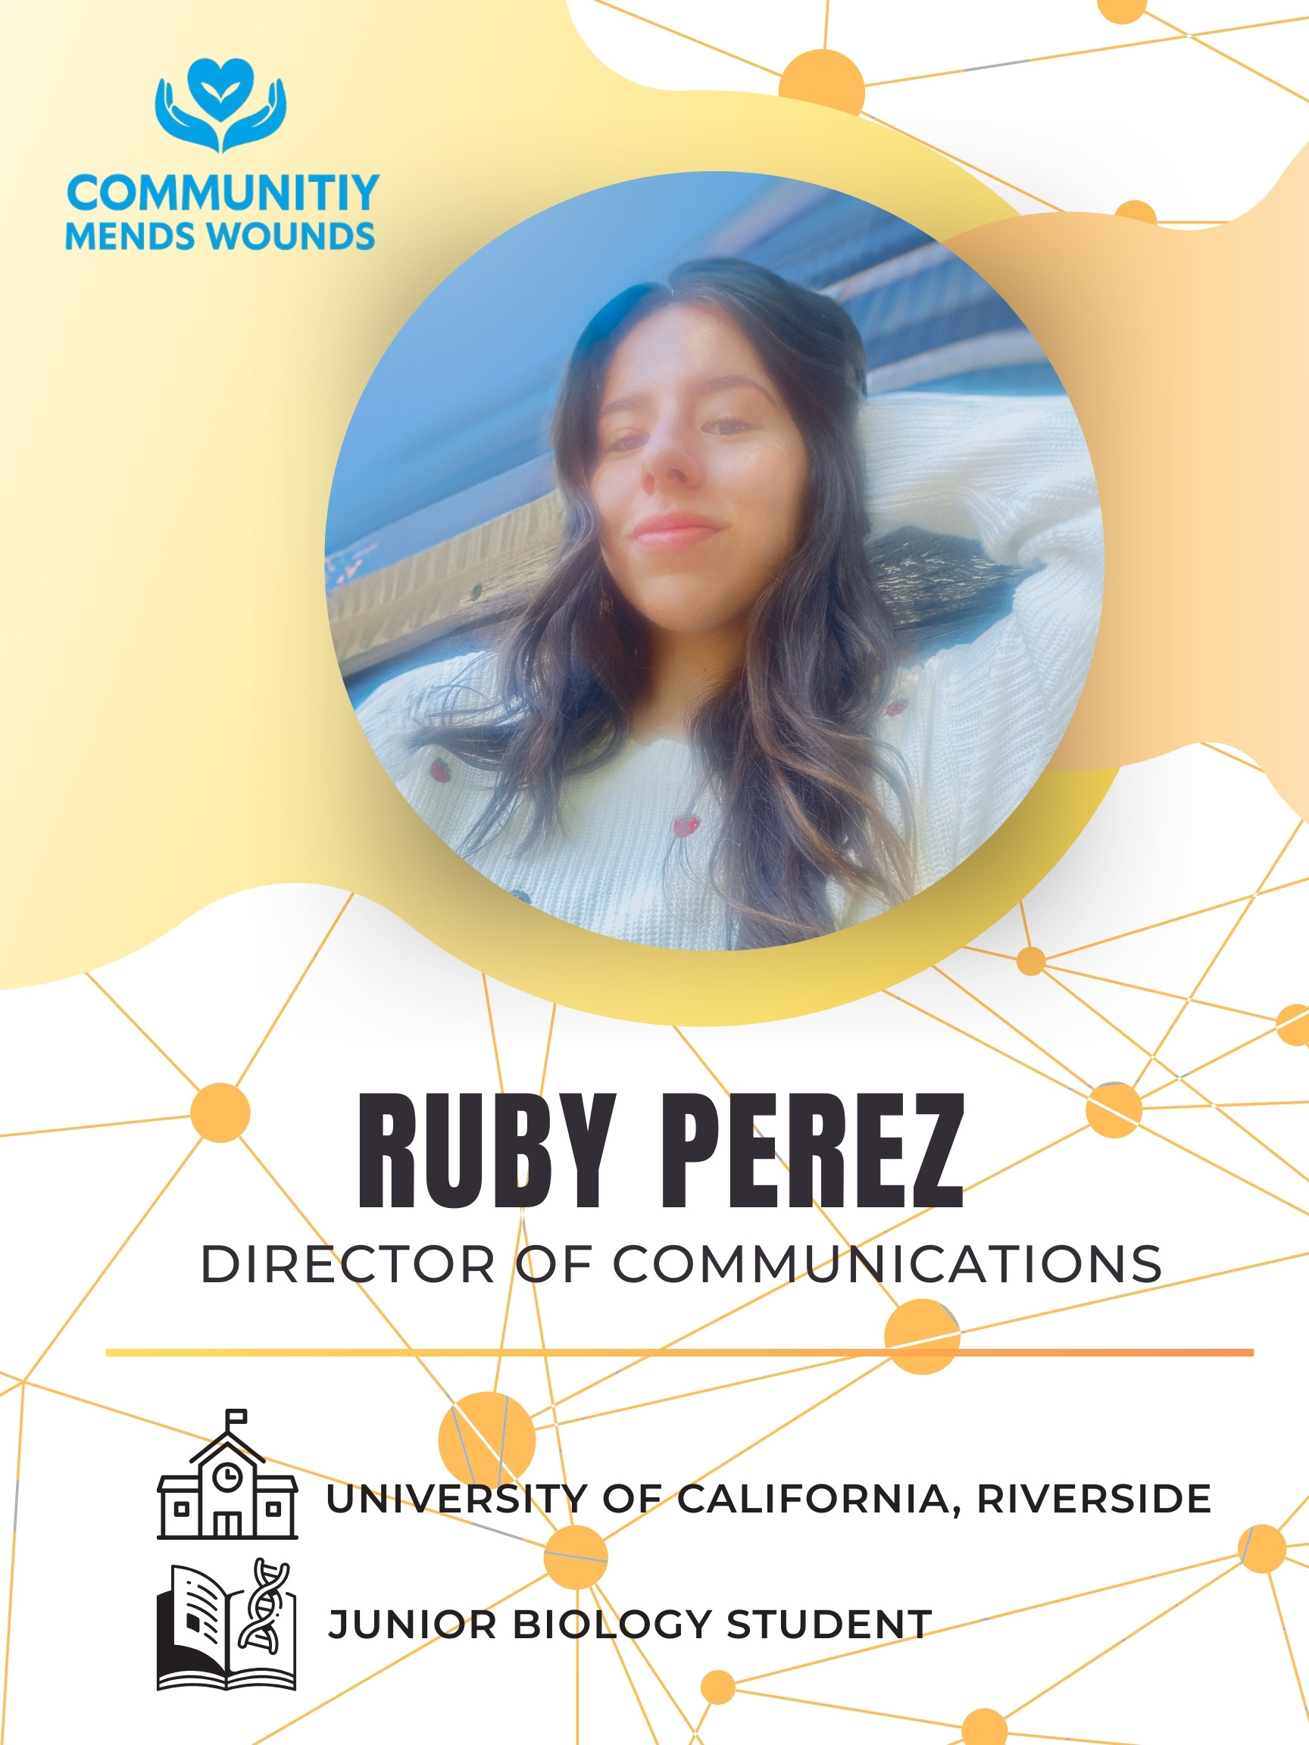

Sustainability
ONGOING OWP PARTNERSHIP (MONTHLY)
CENTRALIZED INVENTORY PUBLICLY ACCESSABLE TO CLINICS & PATIENTS
SEEKING CONTINUING GRANT & SCHOLARSHIP SUPPORT
VOLUNTEER EXPANSION
CHAISR PARTNERSHIP TO IMPROVE COMMUNITY OUTREACH EFFORTS

Slide 7
Lessons
LOGISTICS ARE A LIMITING FACTOR – PICKUP COORDINATION IS VITAL
EMOTIONAL ASPECT OF POST-MORTEM DONATIONS MUST BE HANDLED WITH CARE
CLINICS NEED SIMPLE, LOW-BARRIER METHODS TO REQUEST/ACCESS SUPPLIES
COMMUNITY GOODWILL EXISTS, BUT AWARENESS IS STILL A CHALLENGE

Slide 8
References
Centers for Disease Control and Prevention. (2024). Social determinants of health (SDOH).
Feight, J., Forsyth, A., & Tettelbach, W. (2023). Navigating obstacles impacting the sustainability of Medicare-funded wound care pricing. Journal of Wound Care, 32(11), 720–726.
Merzel, C., & D'Afflitti, J. (2003). Reconsidering community-based health promotion: Promise, performance, and potential. American Journal of Public Health, 93(4), 557–574.
Nussbaum, S. R., Carter, M. J., Fife, C. E., DaVanzo, J., Haught, R., Nusgart, M., & Cartwright, D. (2018). An economic evaluation of the impact, cost, and Medicare policy implications of chronic nonhealing wounds. Value in Health, 21(1), 27–32.

Slide 9
Thank You
Program Email: communitiesmendwounds@gmail.com
Personal: jtorr204@medsch.ucr.edu

