Slide 1
Encouraging Health Literacy in a San Bernardino Youth Center
Rheem Fawaz & Alexander Flores
Inland Empire AHEC

Slide 2
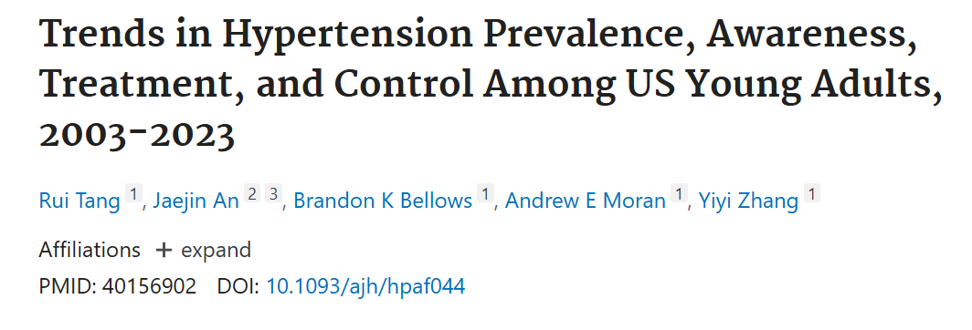
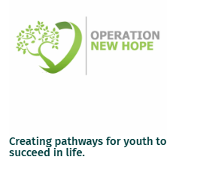
Background
Tang et al. (2025) paper illuminated the paucity of hypertension awareness in those who met criteria.
Many youth in the community have limited opportunities to learn about common health issues in an engaging, relevant way
Partnered with Operation New Hope
Aimed to increase understanding of health concepts while also encouraging interest in healthcare professions
Heart Rate and Blood Pressure
Notes:
Alex

Slide 3
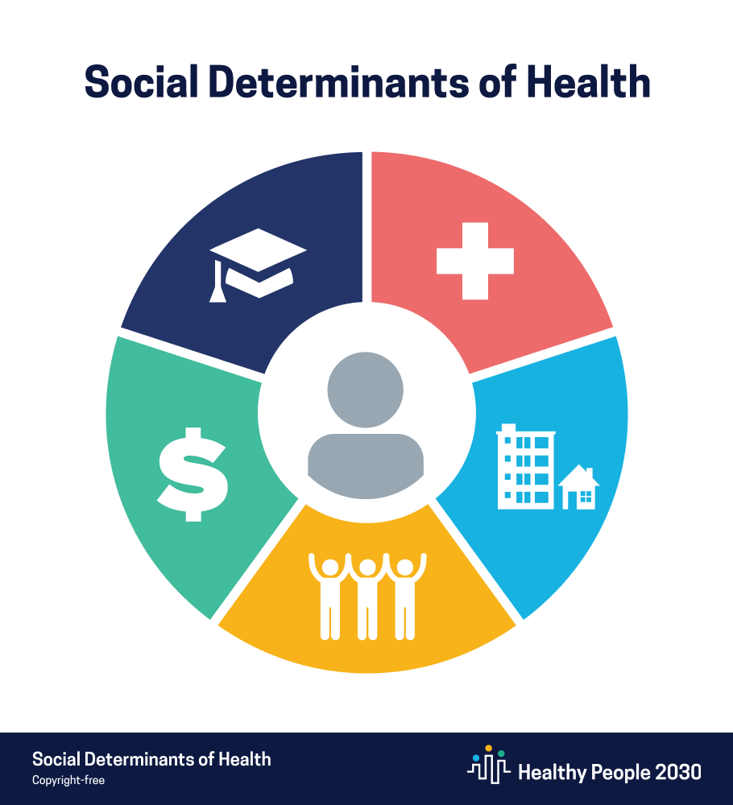
Social Determinants of Health
Education Access and Quality
Schools may lack time or resources to teach basic health concepts
Lack of awareness can contribute to long-term cycles of poor health outcomes
Economic Stability
Presentation was a small step in addressing these two domains

Slide 4

Project Objectives
Increase awareness and understanding of:
Cardiovascular health
Cardiac physical exam
Ways to improve blood pressure
Spark Interest in health sciences
Promote proactive health behaviors
Empower attendees to invest in managing their own health issues and spreading information about cardiovascular health
Notes:
Alex

Slide 5
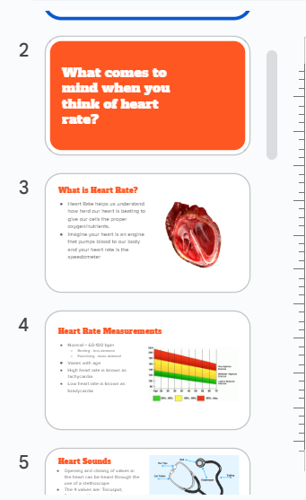
Methods
Designed a presentation specifically for the youth center audience focusing on educating adolescents on blood pressure, heart rate, and heart sounds, integrating feedback from staff with experience working with that age group.
Delivered a one-hour, interactive session with 12–15 participants (ages 15–24), combining instruction with hands-on activities using stethoscopes and sphygmomanometers.
Facilitated small group practice, answered questions, and adapted in real-time to participant curiosity and understanding levels
Notes:
Alex

Slide 6

Outcomes
Success!
Demonstrated active engagement and interaction
Expressed interest in healthcare careers
Reinforced the importance of health literacy
Received positive feedback from the youth center coordinator
Students reported a better understanding of blood pressure and its connection to chronic conditions
Reinforced the value of community-based health education and early career exposure

Slide 7


Sustainability
End of Medical School Approaching
Future Plans: CUSM’s Pediatric Interest Group
Maintaining Relationship with Operation New Hope

Slide 8
Lessons Learned
Gained a deeper understanding of participants' perspectives and lived experiences
Learned the value of flexibility, collaboration, and thoughtful planning when working with community partners
Broadened our understanding on how to deliver health education
Often unfamiliar to general public
Notes:
Alex and Rheem

Slide 9
References
American Heart Association. (n.d.). Target heart rates. https://www.heart.org/en/healthy-living/fitness/fitness-basics/target-heart-rates
Challa HJ, Ameer MA, Uppaluri KR. DASH Diet To Stop Hypertension. [Updated 2023 Jan 23]. In: StatPearls [Internet]. Treasure Island (FL): StatPearls Publishing; 2025 Jan-. Available from: https://www.ncbi.nlm.nih.gov/books/NBK482514/
Flynn JT, et al. Clinical Practice Guideline for Screening and Management of High Blood Pressure in Children and Adolescents. Pediatrics. 2017;140(3):e20171904.
Lloyd-Jones, D.M., & Yancy, C.W. (2019). Heart disease and stroke statistics (in:StatPearls [Internet]). StatPearls Publishing. https://www.ncbi.nlm.nih.gov/books/NBK541010/
Office of Disease Prevention and Health Promotion. (n.d.). Social determinants of health. Healthy People 2030. U.S. Department of Health and Human Services. Retrieved June 19, 2025, from https://odphp.health.gov/healthypeople/priority-areas/social-determinants-health
Tang R, An J, Bellows BK, Moran AE, Zhang Y. Trends in Hypertension Prevalence, Awareness, Treatment, and Control Among US Young Adults, 2003-2023. Am J Hypertens. 2025 Mar 29:hpaf044. doi: 10.1093/ajh/hpaf044. Epub ahead of print. PMID: 40156902.

