Slide 1




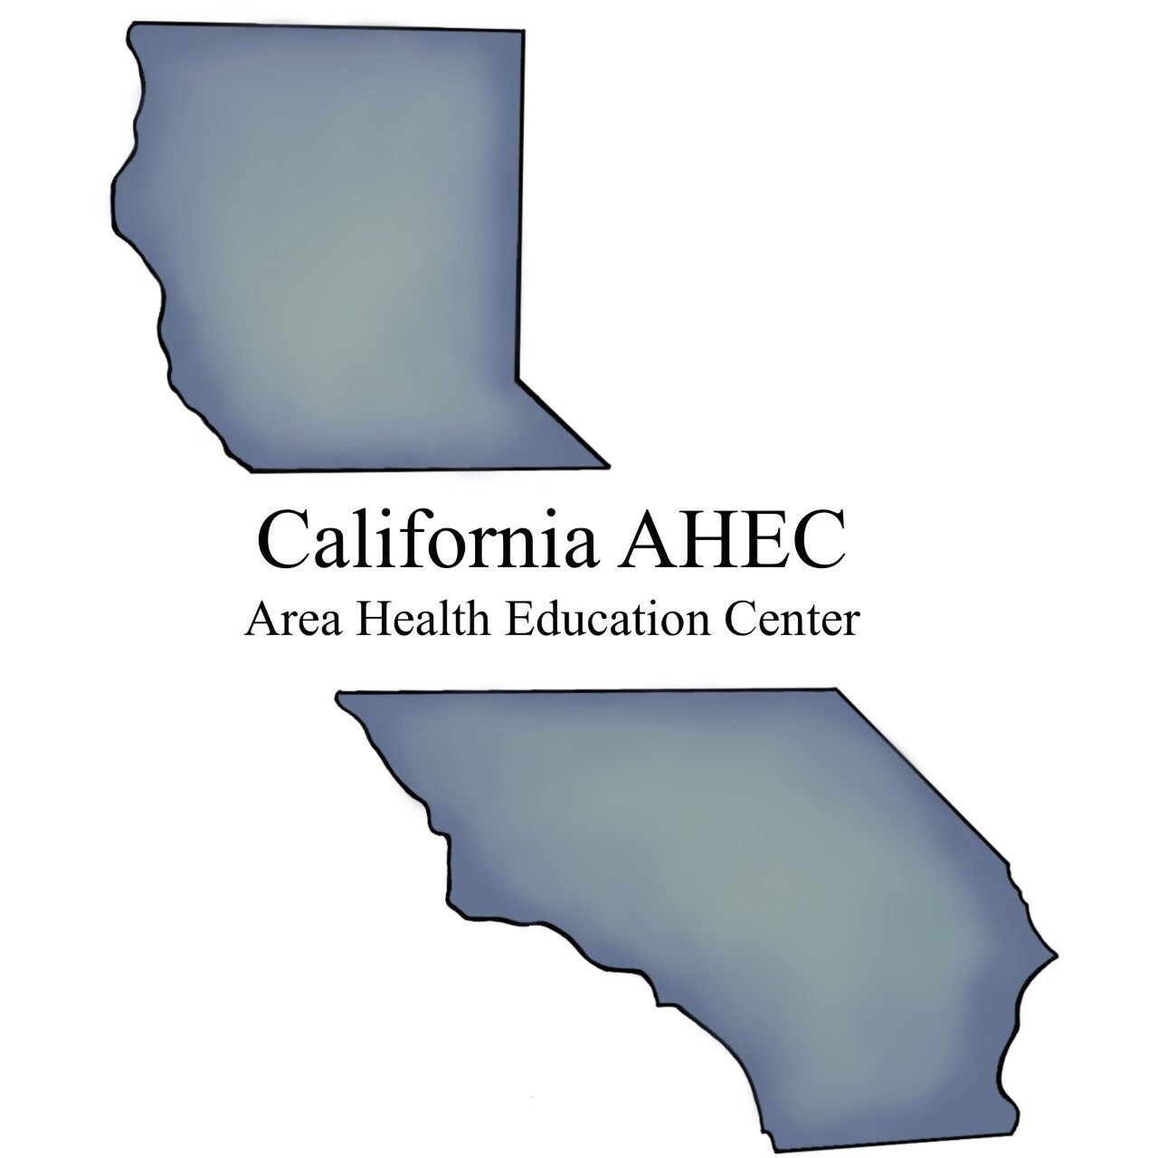



Slide 2
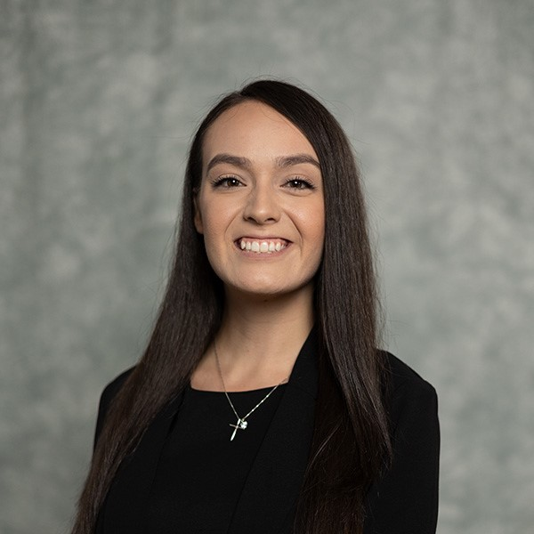
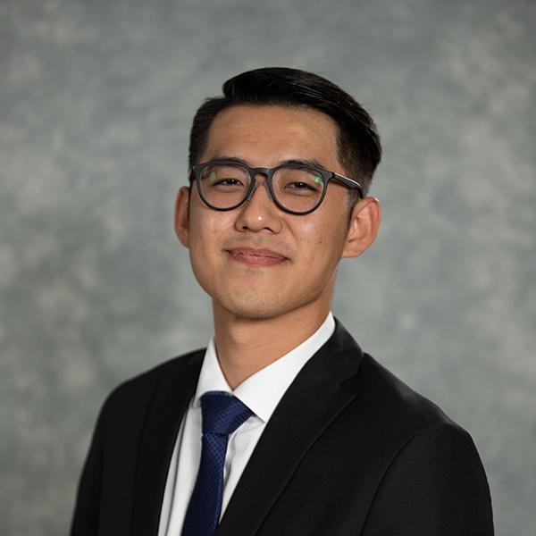

Hello! – Meet our project leaders
Stephanie Jackson
OMS IV
Marcus Chung
OMS IV

Slide 3
Background & Identifying the Need
Melanoma rates are rising in California’s Central Valley—20.6% diagnosed at advanced stages in Tulare County and ~140 new cases annually in San Joaquin County¹
Rural areas face longer wait times, fewer dermatologists accepting Medicaid, and physician shortages, limiting access to care²
Hispanic and rural populations underestimate melanoma risk, especially in darker skin tones, and face barriers like low health literacy³
Hispanic females in rural areas have a 75% higher melanoma incidence rate compared to non-Hispanic White females⁴
National data show consistent rural-urban disparities in cancer trends and access to care⁵
Health need identified via:
NIH State Cancer Profiles
Published research
Community collaboration with local high schools
Notes:
Melanoma, a serious and life-threatening form of skin cancer, continues to be a growing concern in California’s rural areas, particularly in the Central Valley. According to NIH’s State Cancer Profiles, the incidence rate for melanoma of the skin (all stages) in San Joaquin County between 2017 and 2021 was 17.7 (16.4, 19.0) per 100,000 people, with approximately 140 new cases each year [1]. In the neighboring Tulare County, the situation is even more critical, with 20.6% of melanoma cases being diagnosed at a late stage, highlighting the importance of timely recognition and intervention in disease management [1].
Cortez et. al. performed a cross-sectional study revealing significant disparities in access for melanoma screening in California’s Central Valley compared to urban counterparts like in San Francisco [2]. Rural central valley patients had reduced access due to more Medicaid-insured patients, physician shortages, fewer practitioners accepting Medicaid, and longer wait times – issues underscoring the need for improved dermatological healthcare in this area and a greater emphasis on sunscreen use for prevention [2].
Additional studies, such as those by Mesia et al., have explored the factors influencing melanoma awareness and prevention behaviors in rural populations. Findings from 19 focus groups in California regarding melanoma awareness and prevention revealed various factors such as rural location with lack of transportation, low socioeconomic status (SES), and skin color susceptibility perceptions to be influences on skin cancer knowledge, beliefs, and prevention behaviors [3]. Other studies have highlighted the rural disadvantage in melanoma incidence, particularly among Hispanic females living in areas where more than half of the population is rural [4, 5] In regions where the rural population comprised 50% or more, Hispanic females had a higher incidence rate ratio (IRR = 1.75, 95% CI = 1.23 to 2.45) compared to non-Hispanic White females, who had a lower incidence rate ratio (IRR = 0.87, 95% CI = 0.80 to 0.95) [4]. These findings collectively underscore the need for targeted interventions in rural communities to address the growing melanoma burden, particularly through prevention and culturally compassionate education efforts.

Slide 4
Objectives
Deliver interactive, engaging skin cancer education to high school students in a medically underserved rural area.
Improve awareness of melanoma prevention, sun safety, and skin health.
Empower students and their families to adopt protective sun behaviors.
Measure knowledge improvement via pre- and post-surveys.

Slide 5
Methods
Site: Orosi High School, in collaboration with the Academy of Health Sciences
Date: February 27, 2025 | Sessions: 3 class periods | Students: Grades 9–12, ages 14–18
Intervention: 90-minute in-person presentation
Covered skin anatomy, skin cancer types, detection, and prevention with information based on AAD and Skin Cancer Foundation guidelines and reviewed by a board-certified dermatologist
Emphasized representation of all skin tones to improve inclusivity
Integrated Kahoot!, a digital game-based response system, for active learning using visual prompts and competitive quizzes via existing classroom tech
Google Forms used for anonymous pre- and post-surveys (100% completion rate)
Small incentives offered to enhance engagement
Data Analysis: Chi-Square and Mann-Whitney U tests used to compare results (p < 0.05)
Notes:
Analysis:
Mann-Whitney U test for section & overall score comparison
Chi-Square test for changes in question-level accuracy
Data treated as independent samples (unmatched surveys)
Significance threshold: p < 0.05
As an unblinded educational intervention, both participants and facilitators were aware of the intervention content and goals. The project was not part of a larger study, and no control or comparator group was used. Data was analyzed using IBM SPSS Statistics. Since pre- and post-survey responses were not individually matched, data were treated as independent samples. A Mann-Whitney U test was used to compare section and overall scores, while a Chi-Squared Test assessed changes in the proportion of correct responses for individual questions. Statistical significance was set at p < 0.05.

Slide 6
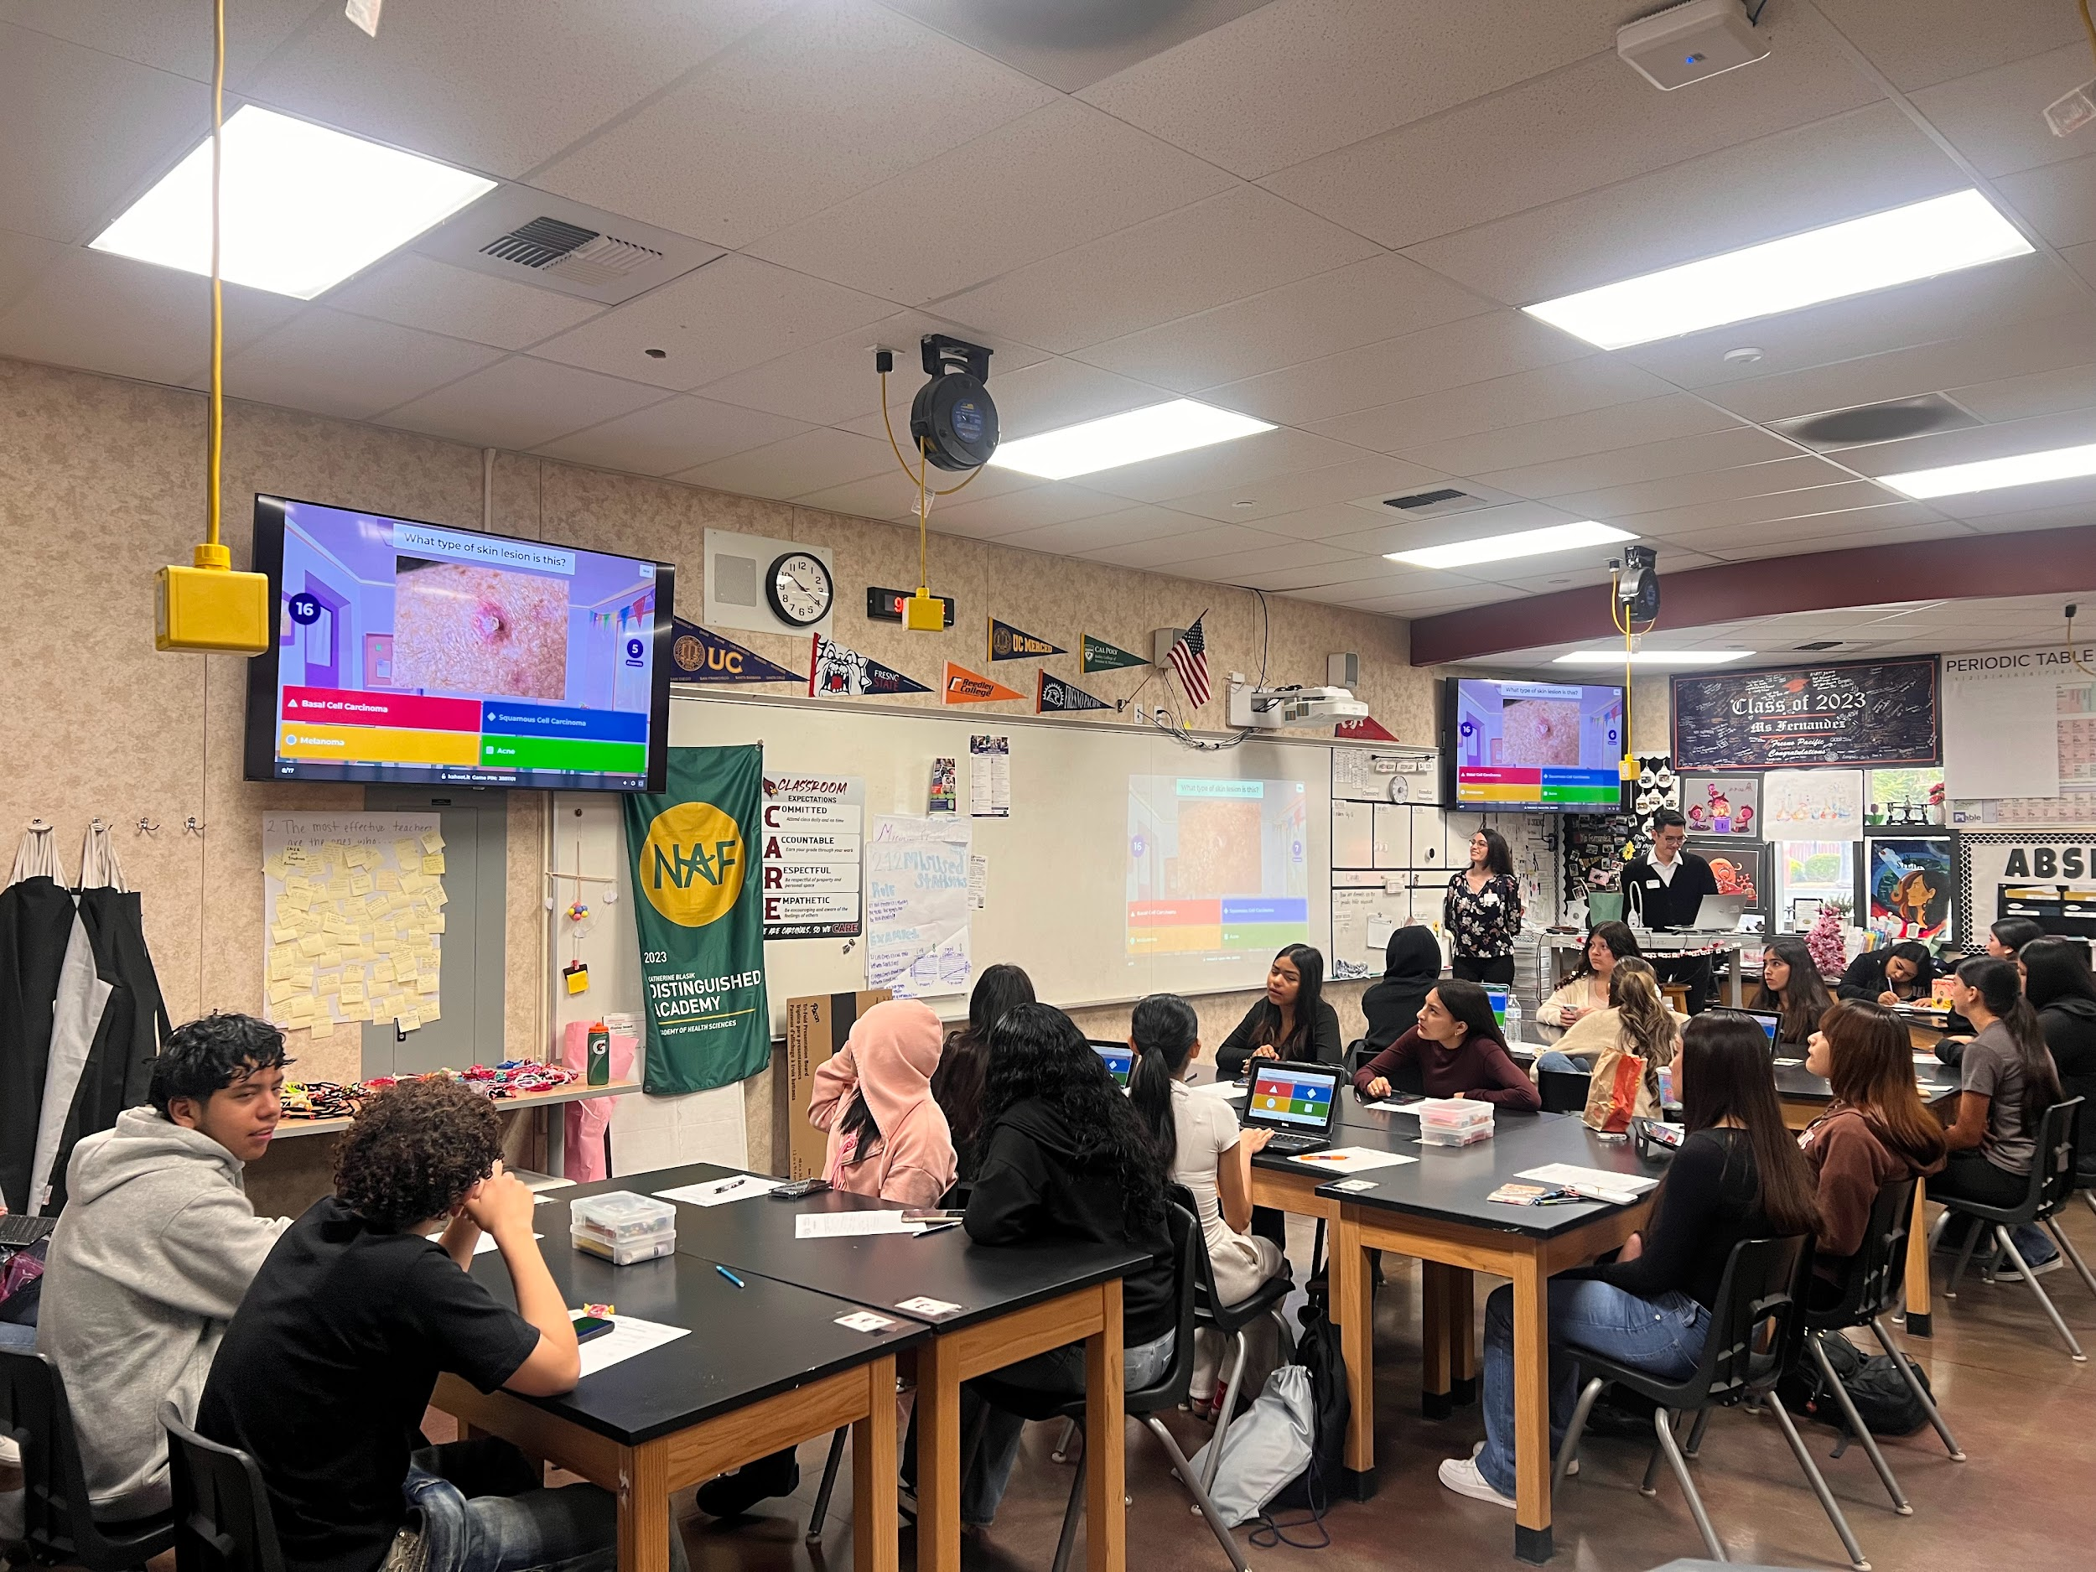
Methods
Notes:
Kahoot

Slide 7
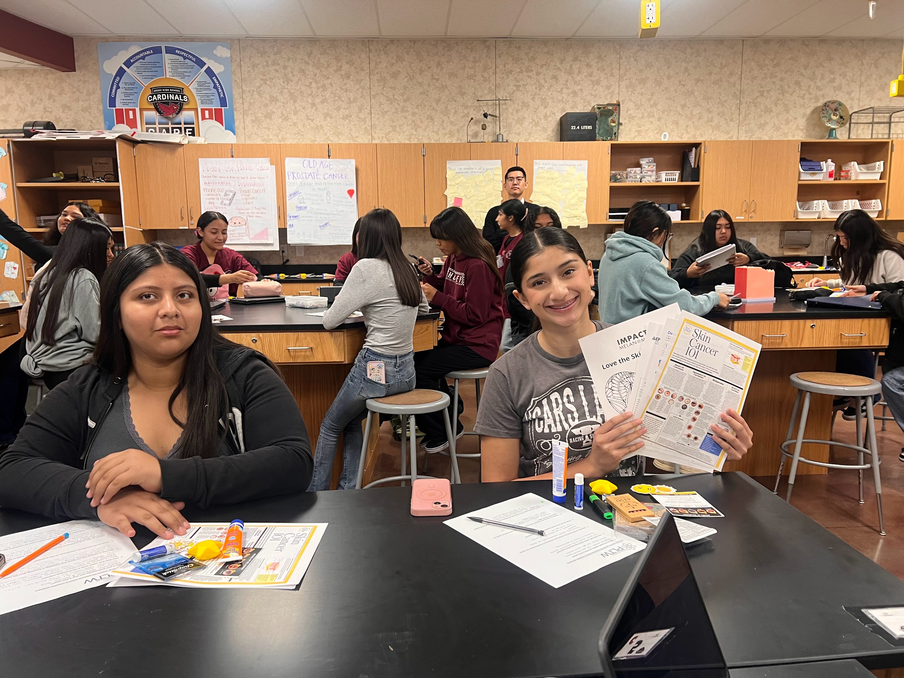
Methods
Notes:
Incentives on the table, sun block, stationeries, stickers, to interact with us

Slide 8
Findings & Outcomes - I
Participants: 95 students (100% survey participation)
Demographics: 85.3% identified as Hispanic/Latino
Baseline gaps:
96.8% did not know how to perform a skin self-exam
Only 7.4% had ever seen a dermatologist
26.3% did not know who or what a dermatologist was

Slide 9
Findings & Outcomes - II
Additional Questions Post-Test N = 95
After this presentation, do you know how to protect your skin from skin cancer? – Count “Yes” (%) | 95 (100.0)
After this presentation, how often do you plan to use sunscreen? - Count (%)
Every day | 80 (84.2)
At least once a week | 8 (8.4)
At least once a month | 5 (5.3)
At least once a Year | 2 (2.1)
After this presentation, do you know how to perform a self-skin exam? – Count “Yes” (%) | 90 (94.7)
After this presentation, how likely are you to seek care from a dermatologist? – Count “Yes” (%)
5 (Very Likely) | 17 (17.9)
4 | 32 (33.7)
3 | 36 (37.9)
2 | 7 (7.4)
1 (Very Unlikely) | 3 (3.2)
Notes:
Increased knowledge in how to perform a skin test (subjectively)

Slide 10
Findings & Outcomes - III
This table shows the scores for each of the sections of the test, including the overall score | Max Possible | Pre-Test Median (IQR) (n = 95) | Post-Test Median (IQR) (n = 95) | p
Section 1: Skin Anatomy Function | 3 | 2 (2 – 3) | 3 (3 – 3) | <.01*
Section 2: Skin Cancer Types | 3 | 1 (0– 2) | 2 (2 – 2) | <.01*
Section 3: Recognizing Skin Cancer | 3 | 1 (1 – 2) | 3 (2 – 3) | <.01*
Section 4: Prevention and Sun Safety | 6 | 3 (2 – 4) | 5 (4 – 6) | <.01*
Section 5: Skin Cancer Across Skin Tones | 2 | 1 (1 – 2) | 2 (1 – 2) | <.01*
Section 6: Dermatological Self-Care | 3 | 2 (2 – 3) | 3 (2 – 3) | <.01*
OVERALL SCORE | 20 | 11 (9 – 13) | 17 (15 – 18) | <.01*
Notes:
The medians and interquartile ranges are show because the data is highly skewed in the post-test (towards perfect scores)
The p-values were calculated using a Mann-Whitney U test to compare pre- and post-test
A Mann-Whitney U test is basically a t-test, but for samples that are not normally distributed
In all sections and overall, the post-test scores were higher than the pre-test
Note: as data was not matched from pre- to post-test, the Mann-Whitney U test assumes that the samples are independent between the tests
Statistically significant

Slide 11
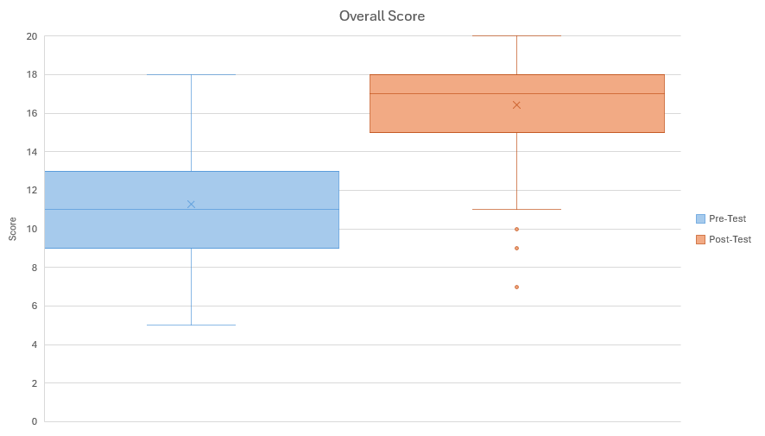
Findings & Outcomes - IV
Boxplots comparing the pre-test and post-test
distribution of overall scores
Median of composite knowledge score increased from 11 (IQR 9–13) to 17 (IQR 15–18) out of 20
Boxplot analysis showed improved median, mean, and decreased variability
Notes:
The line in the middle of the box shows the median and the X marks the mean
Dots below the post-test are outliers

Slide 12
Findings & Outcomes - V
Student feedback:
Increased confidence in detecting signs of skin cancer
Strong engagement with Kahoot! and real-life visual examples
Several students expressed interest in dermatology careers during Q&A

Slide 13
Findings & Outcomes - VI
Were objectives met?
Delivered skin cancer education to rural high school students
Significantly improved sun safety and melanoma knowledge
Empowered students with prevention tools (e.g., SPF, ABCDE, self-checks)
Successfully evaluated impact via pre/post-surveys (statistically significant)
Students felt engaged

Slide 14
Sustainability
Low-cost and replicable model:
Utilized free platforms like Google Forms and Kahoot!
Implemented using existing class periods and school tech
All incentives cost no more than $500 USD including shipping for 95 students
About $5 each student
Ongoing collaboration potential:
Orosi High School expressed interest in annual presentations
Faculty from the Academy of Health Sciences supportive of continued integration with not only dermatology, but also other health related topics, especially stress management and mental health
Potential scalability
Expand to other rural schools with similar demographics, needs and faculty support

Slide 15
Lessons Learned
Culturally relevant education matters
Inclusive visuals representing darker skin tones challenged misconceptions and increased student engagement
Many students had never seen dermatologic conditions on skin like theirs
Game-based learning boosted retention
Kahoot! created excitement and reinforced learning through competition
Visual cues and live interaction kept students focused

Slide 16
Limitations of the Findings
Single-site setting limits generalizability
Results reflect one rural high school with a predominantly Hispanic/Latino population
Unblinded design
Students and presenters knew the project goals, which may have introduced response bias
Surveys were not individually matched
Pre- and post-responses were treated as independent samples, limiting tracking of individual progress
Short-term outcome focus
Long-term behavior change (e.g., sustained sunscreen use or skin checks) was not assessed

Slide 17
Reference
National Cancer Institute. Incidence Rate Report for California by County—Melanoma of the Skin, 2017–2021. California Cancer Registry; 2024. https://statecancerprofiles.cancer.gov
Cortez JL, Fadadu RP, Konda S, Grimes B, Wei ML. Disparities in access for melanoma screening by region, specialty, and insurance: A cross-sectional audit study. JAAD Int. 2022;7:78–85. doi:10.1016/j.jdin.2022.02.008
Mesia RJ, Espinosa PR, Hutchison H, et al. Melanoma awareness and prevention among Latinx and non-Latinx white adults in urban and rural California: A qualitative exploration. Cancer Med. 2023;12(6):7438–7449. doi:10.1002/cam4.5457
Oh DL, Schumacher K, Yang J, et al. Disparities in cancer incidence by rurality in California. J Natl Cancer Inst. 2023;115(4):385–393. doi:10.1093/jnci/djac238
Zahnd WE, James AS, Jenkins WD, et al. Rural-urban differences in cancer incidence and trends in the United States. Cancer Epidemiol Biomarkers Prev. 2018;27(11):1265–1274. doi:10.1158/1055-9965.EPI-17-0430

