Slide 1

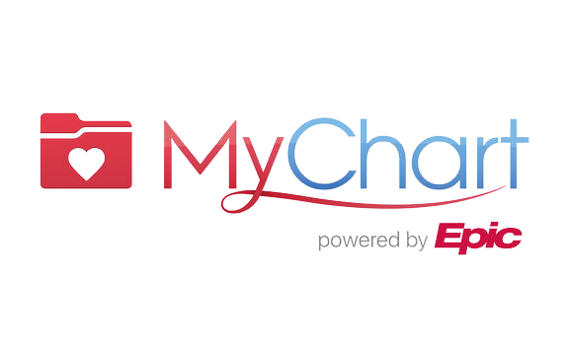


Enhancing MyChart Literacy Among Staff through
CONSENT/ACCESS FLOWCHART
at the Indian Health Center Pediatrics Clinic
BY MAYA GOMEZ

Slide 2




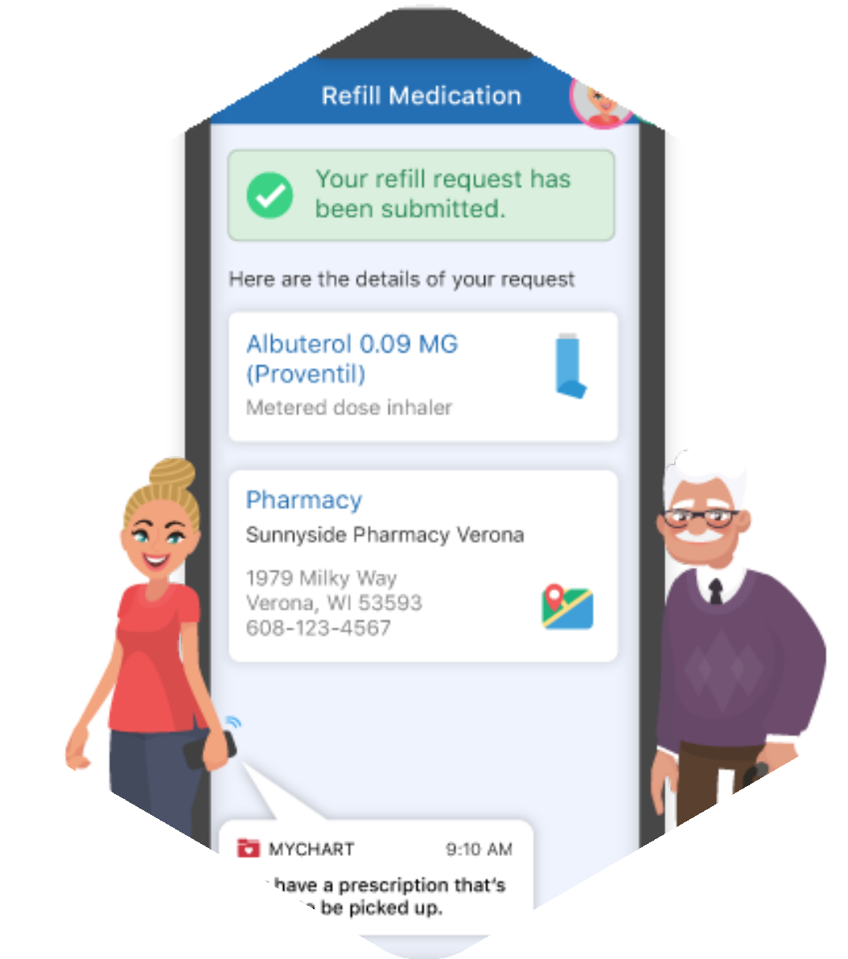


Introduction
Objective: Identify and address a critical health need at the Indian Health Center - Pediatric Clinic
Through collaboration with staff, it became evident that there was a significant challenge in understanding and navigating MyChart proxy access, particularly for patients aged 12-17. This challenge hindered effective patient and guardian enrollment.
My goal was to create a clear, comprehensive, and user-friendly flowchart that explained MyChart proxy access levels and consent requirements for different age groups for the staff to use

Slide 3










Mariana Rivera
Medical Front Office Supervisor at IHC Peds Clinic
Collaborators
at
Mubaraka Kachwala
Electronic Health Record Lead at IHCSCV
Marilyn McGraw
Clinic Manager at IHC Peds Clinic
Jason Dinh
Data Analyst at IHCSCV
Various Staff
Those involved in patient enrollment processes and EHR Support

Slide 4
Health Need/SDOH
Education
Health and Health Care
Health Literacy
“Improvements in health practice that address low health literacy are needed to reduce disparities in health status. As limited health literacy is common and may be difficult to recognize, ‘experts recommend that practices assume all patients and caregivers may have difficulty comprehending health information and should communicate in ways that anyone can understand.’ Examples include: simplifying communication; confirming comprehension for all patients to minimize risk of miscommunication; making the health care system easier to navigate; and supporting patient’s efforts to improve their health.” (“Health Literacy | Healthy People 2020”)
Language/Literacy
“Likewise, literacy and health are interconnected. Limited literacy is a barrier to health knowledge access, proper medication use, and utilization of preventive services. Individuals with limited literacy face additional difficulties following with medication instructions, communicating with health care providers, and attaining health information—all of which may adversely affect their health.” - (“Language and Literacy | Healthy People 2020”)

Slide 5










Health Need/SDOH Cont.
Health and Health Care
Access to Health Services, Access to Primary Care
“Patients with a usual source of care are more likely to receive recommended preventive services such as flu shots, blood pressure screenings, and cancer screenings. However, disparities in access to primary health care exist, and many people face barriers that decrease access to services and increase the risk of poor health outcomes. Some of these obstacles include lack of health insurance, language-related barriers, disabilities, inability to take time off work to attend appointments, geographic and transportation-related barriers, and a shortage of primary care providers. These barriers may intersect to further reduce access to primary care.” (“Access to Primary Care | Healthy People 2020”)

Slide 6











SMART Objectives
S
M
A
R
T
Specific
Create a detailed, user friendly flowchart that clarified MyChart proxy access levels/consent requirements for different age groups to be used by the staff
Measurable
Achievable
Achieve the improvement within a 3-day period, with supervision provided for 8 hours each day, totaling 24
24 is more than the required 10-hour increment necessary for CHIP clinic work
Realistic
Addresses SDOH: Language/Literacy, Health Literacy, and Access to Primary Care/Health Services
How: Improves communication, enhances patient/guardian understanding, improves overall access to health care
Time-phased
50% of the staff working on MyChart enrollment will report increased understanding, confidence, or literacy
Measured by surveys before and after flowchart usage
Complete the implementation/ evaluation from 7/22-7/31

Slide 7








Methodology
01
03
02
04
Initial Assessment
Staff Supervision
Flowchart Design & Consultation
Collaborated with clinic staff to map out necessary information and created draft Consulted with EHR specialists to confirm the accuracy and completeness
Implementation & Feedback
Collected feedback from staff on the clarity and usefulness of the resource
Noted desired adjustments based on feedback
Conducted interviews Administered survey to clinic staff
Analyzed feedback & data for key barriers and challenges
Administered the flowchart to staff after confirming accuracy Supervised clinic staff over 3 days, providing 8 hours of supervision each day to ensure understanding

Slide 8
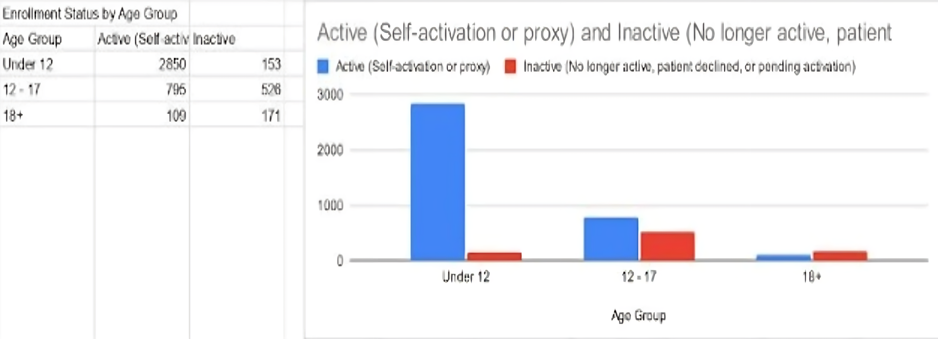
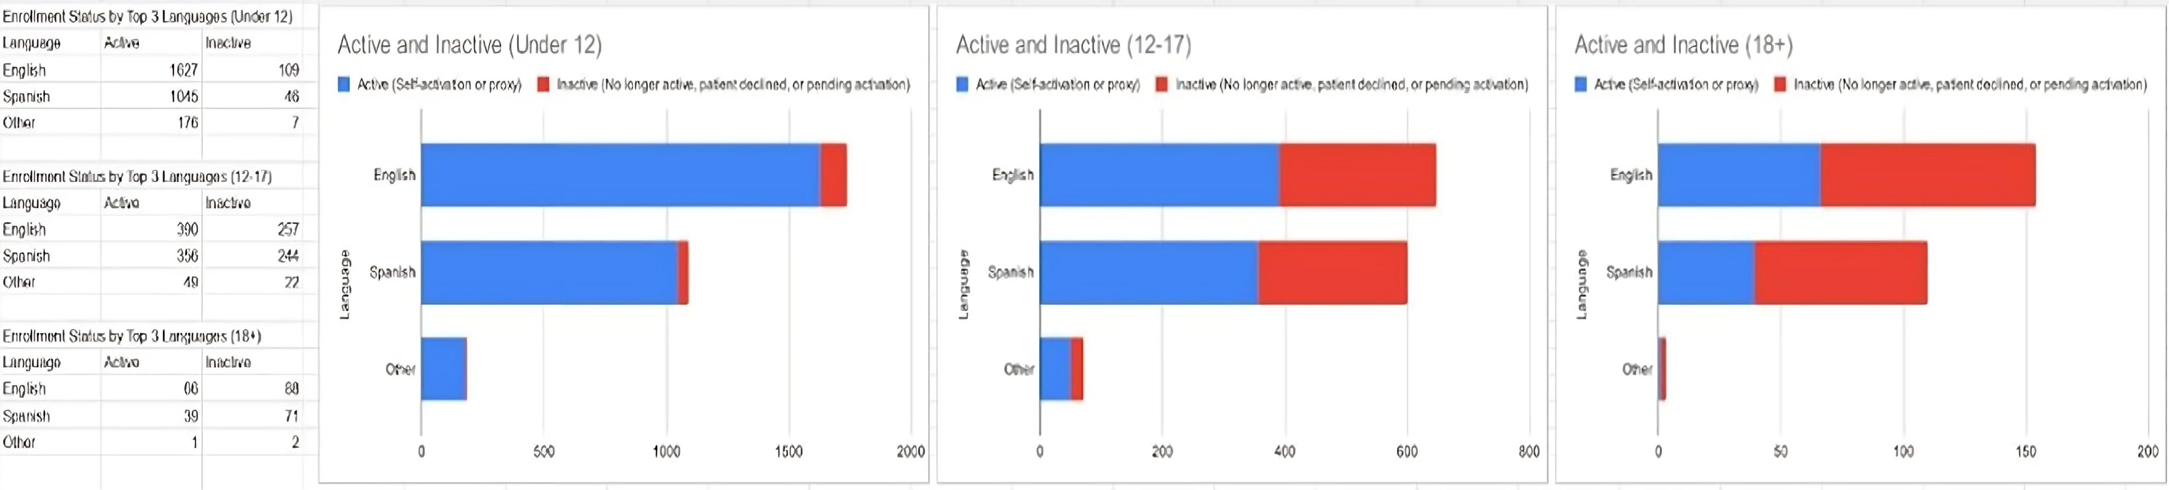
MyChart Enrollment Among Ped. Pts

Slide 9
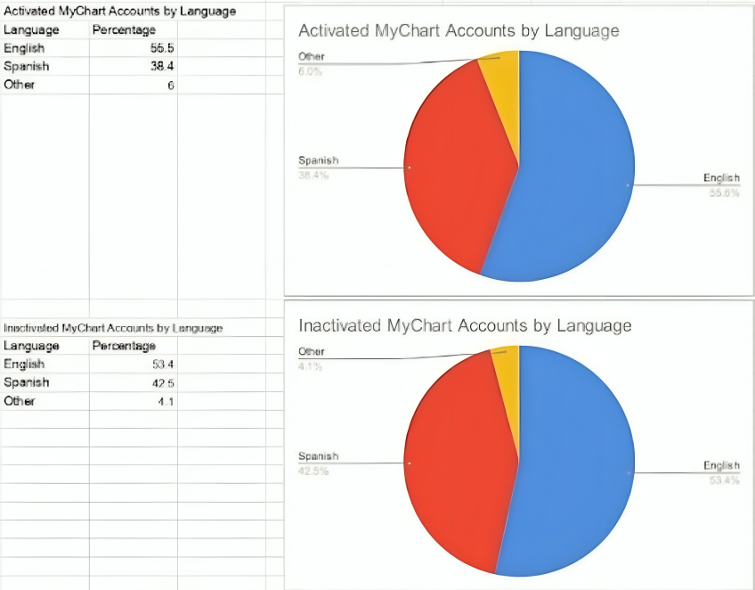
MyChart Enrollment Among Ped. Pts

Slide 10


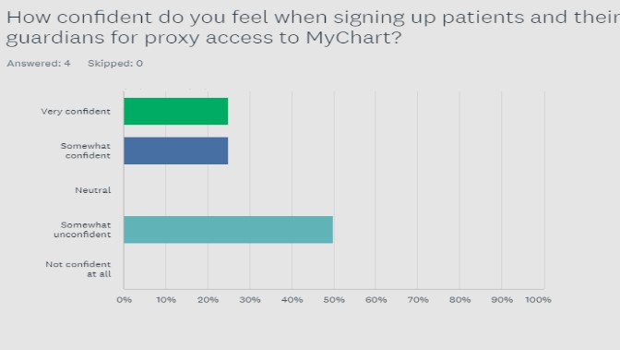
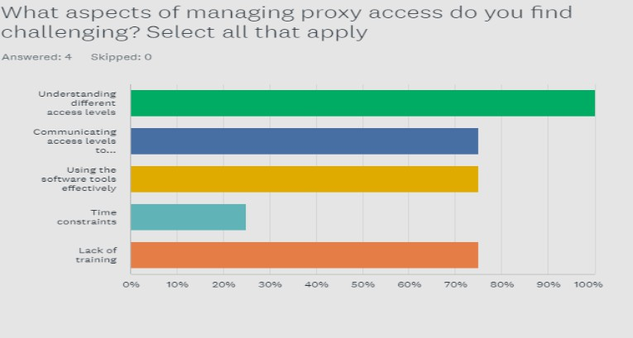
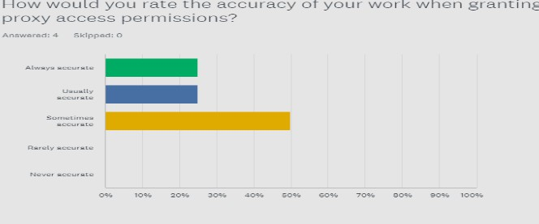
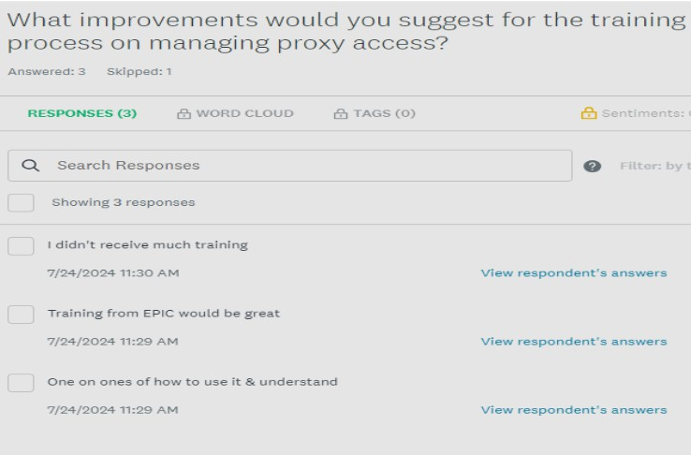

Survey 1 - Staff Confidence

Slide 11
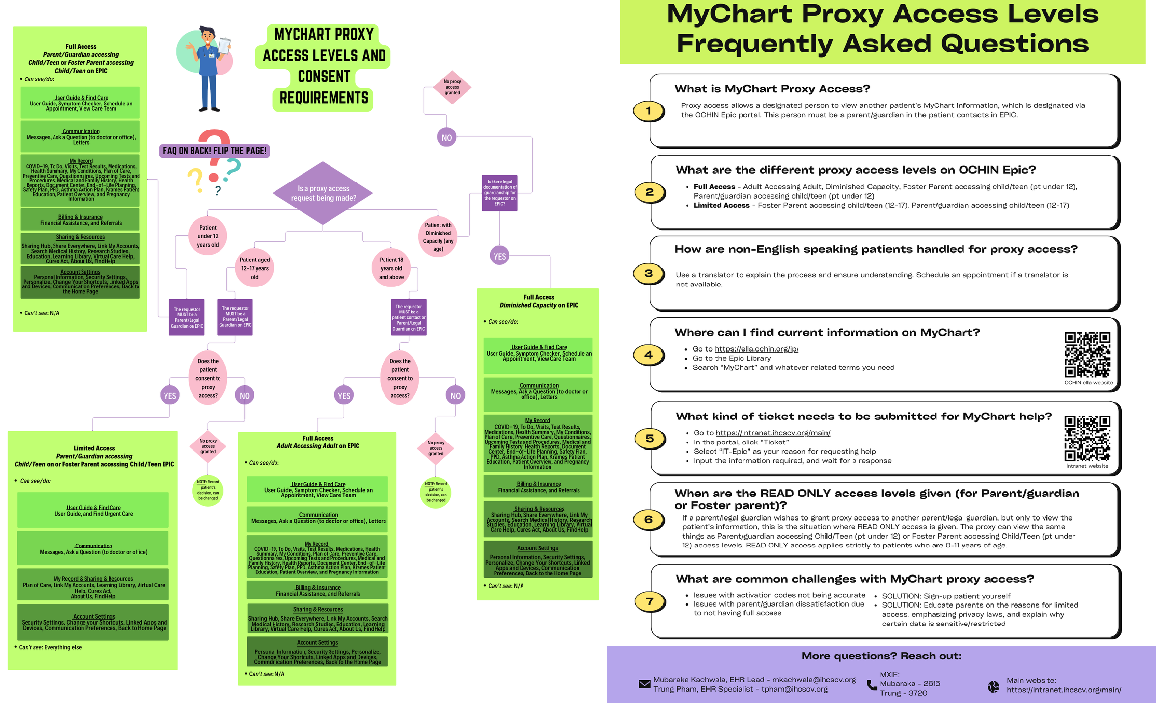

Slide 12
Survey 2 - Staff Satisfaction
Scale:
5 = Highest positive response (e.g., Very Confident, Very Useful)
1 = Lowest response (e.g., Not Confident at all, Not Useful at all)
Survey Question | Average Response
How confident do you feel in your ability to explain MyChart access levels and consent requirements after using the new flowchart? | 3.5 / 5
How useful do you find the flowchart for handling MyChart proxy access enrollment for non-English speaking patients? | 4.75 / 5
How likely are you to use this flowchart in the future? | 5 / 5
How well do you understand the different MyChart proxy access levels and consent requirements for various groups after examining the flowchart? | 3.25 / 5
Overall, how satisfied are you with the information provided in this project? | 5 / 5
How easy is the flowchart to use when explaining MyChart proxy access enrollment to patients and their guardians? | 4.75 / 5

Slide 13
Survey 2 - Staff Satisfaction cont.
What staff found most helpful about the new flowchart:
Clear descriptions of MyChart’s purpose and the types of access available.
Visual representation of the access and enrollment process.
Improved clarity for accurate patient enrollment, especially valuable given the previous lack of formal training.

Slide 14






Data Interpretation
Outcome
50% of staff reported they felt “very confident” in ability to explain MyChart access levels/consent requirements - improved staff literacy
75% found the flowchart “very easy” to use when explaining MyChart proxy access enrollment to patients/guardians - improved staff understanding, addresses Health Literacy/Access to Health Services/Access to Primary Care
75% found the flowchart “very useful” for
handling non-English speaking patients - addresses Language/Literacy
100% of staff said they were “very likely” to
use the flowchart in the future, and “very satisfied” with the information provided

Slide 15










Sustainability
Incorporate the flowchart into reg. management
Collect feedback from patients, and staff on enrollment processes and expectations - surveys, suggestion boxes
Review when necessary for updates
Make it digitally available, if deemed beneficial
Track performance metrics like # of active MyChart accounts, patient satisfaction, and staff literacy levels to illustrate impact

Slide 16




Lessons/Takeaway
Effective communication/collaboration when pursuing any initiative to improve workflow is very important
Clear and concise communication is essential for both staff and patients to understand MyChart access/consent requirements
MyChart training was greatly desired, despite improvements - beneficial to maintain literacy/address any concerns
Cultural competency and patient engagement are especially important, illustrated by IHC Peds statistics

Slide 17



THANK YOU FOR LISTENING

