Slide 1
Mapping Inequity in the San Joaquin Valley (SJV): COVID-19 Vaccination Access and Social Vulnerability in Fresno County, CA (2020-2024)
Ajmeet Pama-Ghuman, B.S., Nickie Yang, B.S., Faaizah Arshad, B.A., Seth Blumberg, M.D., PhD.
UCSF School of Medicine, San Francisco, CA
CA AHEC Scholars Symposium – 2026
Notes:
AJMEET
Good evening, it's my pleasure to showcase this COVID-19 disparities project alongside my colleagues, Nickie Yang and Faaizah Arshad. As UCSF medical students on the SJV PRIME track, we had the opportunity to work closely with ID physician, Dr. Seth Blumberg in SF to devise our own passion project focused on Fresno County, CA.

Slide 2
Background
Fresno County ranked as one of the lowest counties in health outcomes and health factors in 2022
Various outreach efforts to increase COVID-19 vaccination rates throughout Fresno County
Limited geographic analyses of COVID-19 vaccination rates and outcomes
Inform future public health and pandemic response strategies
Notes:
NICKIE:
To provide some background, Fresno County ranks among the lowest counties in California for both health outcomes, such as length and quality of life, and health factors, like health behaviors, socioeconomic conditions, and the physical environment. A major contributor to these rankings is how medically underserved Fresno is and the persistent health disparities.
In response to these challenges during the COVID-19 pandemic, the Fresno County Department of Public Health partnered with community-based organizations and healthcare providers to increase vaccine access through mobile clinics, pop-up vaccination sites, school-based events, and other outreach initiatives.
Although vaccination rates from these initiatives have been widely reported, there has been limited research examining the geographic patterns of COVID-19 outcomes across Fresno County. By analyzing the geographic distribution of COVID-19 vaccination coverage and visualizing the outcomes, this project aims to generate insights that can help guide future public health interventions and strengthen pandemic response strategies in medically underserved communities.
Health outcomes:
Length of Life
Quality of Life
Health Factors:
Health behaviors (tobacco use, diet & exercise, alcohol & drug use, sexual activity)
Social & economic factors (education, employment, income, family & social support, community safety)
Physical Environment (air & water quality, housing & transit)

Slide 3
Objectives
  1) Visualize the distribution of COVID-19 vaccination sites with social vulnerability index by zip code as a covariate (2020-2023)
  2) Evaluate the relationship between vaccination trends and zip-code specific SVI, vaccination site type, and race/ethnicity (2021-2022)
  3) Evaluate the relationship between COVID-19 mortality trends and demographic factors [race/ethnicity, sex, comorbidities, education] (2020-2024)
Notes:
FAAIZAH

Slide 4
Objective 1 & Methods
1) Visualize the distribution of COVID-19 vaccination sites with social vulnerability index by zip code as a covariate:
2022 social vulnerability index (SVI) dataset by zip code obtained from Centers for Disease Control and Prevention (CDC)
Overlaid with Fresno County hospital facilities and FCDPH-provided lists of affiliated vaccination sites
Mapped using ArcGIS software: https://arcg.is/0mXbe90
Notes:
FAAIZAH

Slide 5
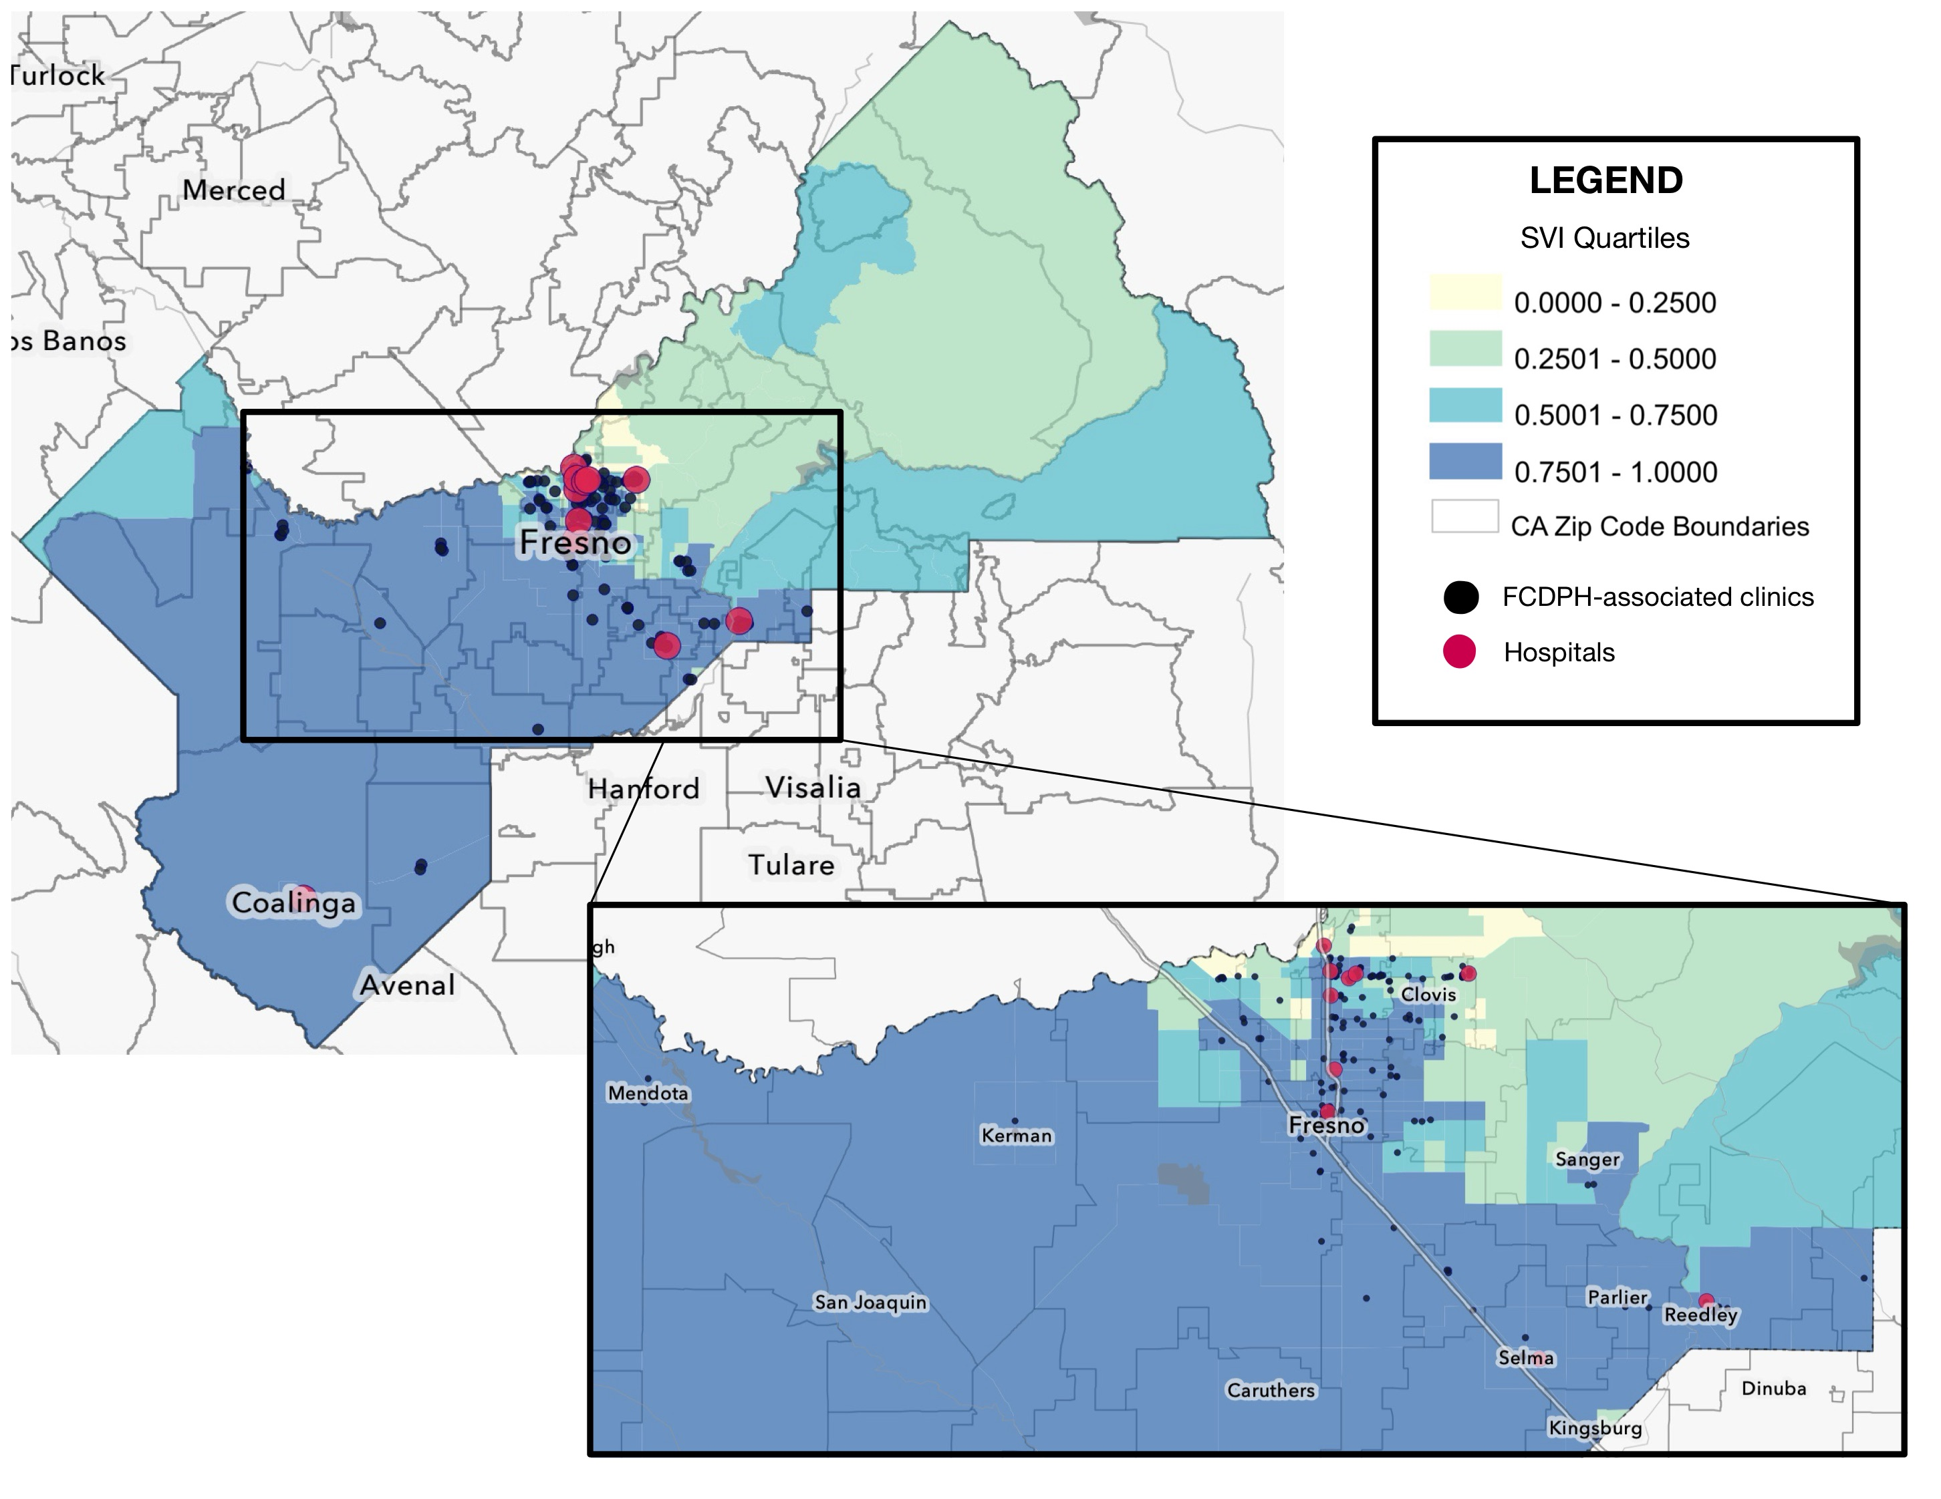
Objective 1 Findings
Major hospitals are regionally concentrated; FCDPH-associated clinics in high-SVI zip codes​
Notes:
FAAIZAH
Figure 1. Geographic distribution of hospital facilities and FCDPH-affiliated vaccination clinics between 2020-2023 in Fresno County, CA, relative to 2022 CDC Social Vulnerability Index (SVI) by zip code.
207 FCDPH-affiliated clinics (black pinpoints) hosted between 2020-2023 (however not a complete picture b/c FCDPH didn't have a running list of all mobile events/pharmacies/etc)
11 hospital locations (red pinpoints)
ArcGIS Map:
Zip code boundaries
Shaded based on 2022 CDC SVI quartiles
Major hospitals are regionally concentrated; FCDPH-associated clinics in high-SVI zip codes
Most major hospitals in Fresno County are regionally concentrated within one area, with the three largest centers reporting higher COVID-19 hospitalization and ICU admission rates, and FCDPH-affiliated vaccination sites predominantly in high-SVI zip codes (Fig 1). Summarize and cite Table 3.1 and 3.2 in your discussion from FCDPH report, no need to include screenshots

Slide 6
Objective 2 & Methods
2) Evaluate the relationship between vaccination trends and zip-code specific SVI, vaccination site type, and race/ethnicity (2021-2022):
CalHHS COVID-19 Vaccine Progress Dashboard Data by ZIP Code dataset: % of residents fully vaccinated, partially, or boosted for each zip code.
UC-CDPH vaccination rates were stratified by race/ethnicity. UC-CDPH categories of vaccination sites were summarized. However, they are not used as a reliable proxy for patient residence.
  Figures generated using GraphPad v11.
Notes:
AJMEET
2) Evaluate the relationship between vaccination trends and zip-code specific SVI, vaccination site type, and race/ethnicity (2021-2022):
CalHHS COVID-19 Vaccine Progress Dashboard Data by ZIP Code dataset: % of residents fully vaccinated, partially, or boosted for each zip code.
UC-CDPH vaccination rates were stratified by race/ethnicity. UC-CDPH categories of vaccination sites were summarized. However, they are not used as a reliable proxy for patient residence.
Figures generated using GraphPad v11.

Slide 7
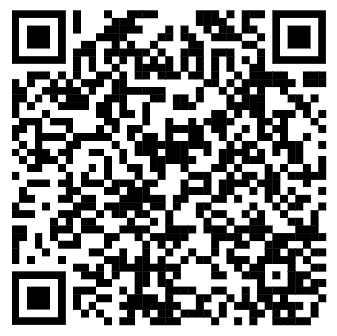
How is SVI associated with vaccination rates?
Table 1.1 |  |  | Jan - Dec 2021 |  |  | Jan - July 2022
SVI Quartiles | Population (age 5+) | # of zip codes | Fully | Partially | Booster | Fully | Partially | Booster
0.0000-0.2500 | 73760 | 9 | 57.19% | 7.06% | 18.94% | 62.90% | 6.45% | 29.05%
0.2501-0.5000 | 114954 | 6 | 71.01% | 6.78% | 20.04% | 75.56% | 6.63% | 38.65%
0.5001-0.7500 | 113770 | 7 | 64.07% | 7.15% | 19.05% | 69.51% | 6.80% | 29.15%
0.7501-1.0000 | 608596 | 34 | 59.33% | 7.37% | 15.85% | 66.13% | 7.14% | 28.49%
Scan the QR code for the complete dataset.
Zip codes in the HIGHEST and LOWEST SVI quartiles had the lowest vaccination rates. Zip codes in MID-range SVI quartiles had the highest vaccination rates. ​
Mapping Inequity in the San Joaquin Valley (SJV): COVID-19 Vaccination Access and Social Vulnerability in Fresno County, CA (2020-2024)​
Notes:
Feedback from Dr. Blumberg: clarify low vs higher SVI when speaking, interpreting the findings – what does it mean that the highest and lowest had higher %s – throw some ideas out there (Data weaker in one of them? Timing of the study? Political association?)
AJMEET
EMPHASIZE MEANING OF EACH SVI QUARTILE
Table 1.1 summarizes the following for each SVI quartile:
the number of Fresno County zip codes in each quartile
the number of Fresno County residents with age 5+
median percentage of Fresno County residents who were fully vaccinated, partially vaccinated, or received their booster COVID-19 vaccine between two time periods, Jan - Dec 2021 and Jan - July 2022
Zip codes in the HIGHEST and LOWEST SVI quartiles had the lowest vaccination rates. Zip codes in mid-range SVI quartiles had the highest vaccination rates.
Our preliminary interpretation > most Fresno County residents resided in the highest-SVI quartile, where vaccination rates remained lower than in moderately vulnerable communities, suggesting that disparities in vaccine uptake were concentrated among the populations at greatest social risk.
Additionally, behavioral, social, and belief-related factors likely influenced vaccination rates, however they were not explored.

Slide 8
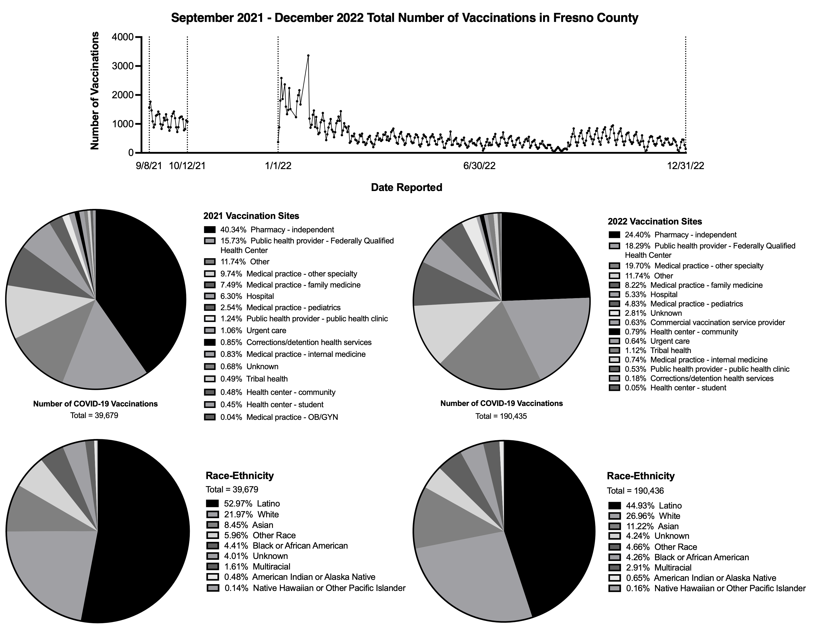
Where were people getting vaccinated in 2021?
In 2021, the predominant vaccination site was "Pharmacy-independent", and second was a "Public health provider-Federally Qualified Health Center".
Mapping Inequity in the San Joaquin Valley (SJV): COVID-19 Vaccination Access and Social Vulnerability in Fresno County, CA (2020-2024)​
Notes:
AJMEET
Figure 2. Total number of COVID-19 vaccine doses in Fresno County by demographic characteristics of recipients and type of vaccination site between September 2021 - December 2022.
Pie charts for 2021 and 2022 show the predominant vaccination sites. Time periods were determined based on limitations in the dataset available. Individual-level data were not available thus cross-tabulation between dose numbers was not possible.

Slide 9
Where were people getting vaccinated in 2022?
In 2022, the top two predominant vaccination sites were the same as in 2021; however, "Medical practice (specialty other than family med/peds/IM)" shared more volume than it had in 2021, making "Pharmacy" less predominant.
Notes:
AJMEET
Figure 2. Total number of COVID-19 vaccine doses in Fresno County by demographic characteristics of recipients and type of vaccination site between September 2021 - December 2022.
Pie charts for 2021 and 2022 show the predominant vaccination sites. Time periods were determined based on limitations in the dataset available. Individual-level data were not available thus cross-tabulation between dose numbers was not possible.

Slide 10
Which race/ethnicity made up the greatest % of vaccinations?
 |  | September – October 2021 | January – December 2022
Race |  | Vaccinating Population [%] | Vaccinating Population [%]
Latinx |  | 21019 [4%] | 85,572 [16%]
White |  | 8716 [3%] | 51,350 [19%]
Asian |  | 3354 [4%] | 21,259 [19%]
Black or African American |  | 1750 [4%] | 8,104 [18%]
American Indian or Alaskan |  | 189 [3%] | 1,244 [20%]
Native Hawaiian or Other |  | 57 [5%] | 310 [25%]
Multiracial |  | 639 [-] | 5540 [-]
Other Race |  | 2365 [-] | 8879 [-]
Unknown |  | 1590 [-] | 8078 [-]
In 2022, Latinx individuals made up the majority of individuals receiving COVID-19 vaccinations in Fresno County, but the minority of within-race/ethnicity calculated proportion of vaccinating individuals.
Notes:
AJMEET
Feedback from Dr. Blumberg: explain methods more simpler: reverse the order -> go over first column and then go into vaccinating percentage and then talk about count/number
Latinx made up the smallest percentage of vaccinations in their race, and this is particularly consequential because latinx made up majority of the county.
Latinx made up the smallest percentage of vaccinations in their race
Emphasize vaccinating population, not an accumulative value but data was showing trend in people actively getting vaccinated

Slide 11
Objective 3 & Methods
3) Evaluate the relationship between COVID-19 mortality trends and demographic factors [race/ethnicity, sex, comorbidities, education] (2020-2024):
UC-CDPH individual-level death reports stratified by demographic factors (2020-2024):
  Race/ethnicity, sex, comorbidities, and education level
Per FCDPH, comorbidity data was derived from death certificates and may be incomplete or underreported.
Figures generated using GraphPad v11.
Notes:
NICKIE
For our 3rd objective, we evaluated the relationship between COVID-19 mortality trends and demographic factors such as race/ethnicity, sex, comorbidities, and education between 2020-2024 by stratifying the the individual level death reports from the UC-CDPH dataset by these factors
One limitation to note is that comorbidity information was derived from death certificates and may be incomplete or underreported, according to the Fresno County Department of Public Health.

Slide 12
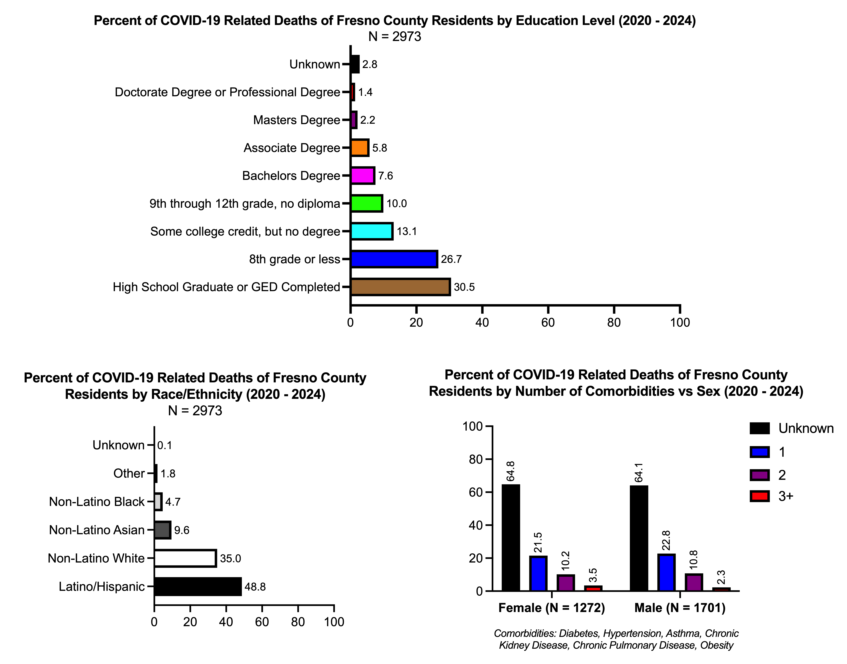
Which race/ethnicity made up the majority of deaths?
Percentage of COVID-19 Related Deaths Per Race/Ethnicity
Race | County Population [%] | COVID-19 Related Deaths Per Race/Ethnicity [%]
Unknown | - | -
Other | - | -
Non-Latino Black | 44,295 [4.4%] | 140 [0.32%]
Non-Latino Asian | 109,665 [10.9%] | 285 [0.26%]
Non-Latino White | 271,889 [27%] | 1,041 [0.38%]
Latino/Hispanic | 540,743 [53.6%] | 1,450 [0.27%]
In 2022, Latino individuals made up the majority of individuals with COVID-19 related deaths in Fresno County, but the deaths per population size showed similar percentages.
Mapping Inequity in the San Joaquin Valley (SJV): COVID-19 Vaccination Access and Social Vulnerability in Fresno County, CA (2020-2024)​
Notes:
NICKIE
When examining COVID-19 deaths by race and ethnicity, Latinx individuals accounted for the largest number of deaths in Fresno County. However, this finding should be interpreted in the context of Fresno County’s population demographics, as Latinx residents also represent the largest racial and ethnic group in the county.
When we adjusted for population size and examined deaths as a percentage of each racial and ethnic group's total population, the mortality percentages were relatively similar across groups. This suggests that while the absolute number of deaths differed, the overall burden of mortality was more comparable when accounting for population size.
These findings may reflect the impact of Fresno County Department of Public Health outreach efforts to improve access to COVID-19 resources and vaccination services across diverse communities.

Slide 13
Were COVID-19 deaths associated with comorbidities?
/0
The majority of COVID-19 related deaths in both males and females had an unknown/0 # of comorbidities. Small percentage had more than 3 comorbidities.
Mapping Inequity in the San Joaquin Valley (SJV): COVID-19 Vaccination Access and Social Vulnerability in Fresno County, CA (2020-2024)​
Notes:
NICKIE
This graph shows COVID-19 deaths by number of comorbidities and sex. Overall, the distribution was very similar between females and males. Notably, over 60% of deaths in both groups were classified as having either zero comorbidities or an unknown number of comorbidities.
These findings highlight an important limitation in the dataset. Documentation of comorbidities appears to have substantial gaps, and improved reporting could help us better understand the factors contributing to COVID-19 mortality. In particular, distinguishing between truly having no comorbidities and having missing or unknown comorbidity data would provide a clearer picture of patient risk factors.
At the same time, it is notable that a substantial proportion of deaths were not documented as having multiple comorbidities. While this may reflect incomplete reporting, it also serves as a reminder that severe COVID-19 outcomes are not limited to individuals with numerous underlying conditions. Public health interventions should continue to reach the broader population while ensuring that high-risk groups remain a priority.
EMPHASIZE THAT DEATH CERTIFICATES DO NOT ACCURATELY DOCUMENT COMORBS > documentation has gaps and could be improved to better understand what is contributing to these deaths
Ideally we would want chart review of these patients to actually look at comorb data
Disconcordance of what's happening vs thought indicates need for more research

Slide 14
Was education level associated with COVID-19 deaths?
Individuals with a "high school degree or GED" and "8th grade or less" composed the highest percentage of COVID-19 related deaths of Fresno County.
Mapping Inequity in the San Joaquin Valley (SJV): COVID-19 Vaccination Access and Social Vulnerability in Fresno County, CA (2020-2024)​
Notes:
NICKIE
Lastly, when examining COVID-19 deaths by education level, we found that more than half of all deaths occurred among individuals whose highest level of education was a high school diploma or GED, or eighth grade education or less.
It is important to note that this is a preliminary analysis. We are currently contextualizing these findings by comparing them to the overall educational distribution of Fresno County’s population. One potential explanation for this pattern is lower health literacy, which may affect access to health information, preventive measures, and healthcare resources, potentially increasing vulnerability to COVID-19 and its complications.
Feedback: if we could, include denominator similar to slide 11 (if not, we can include as work in progress)
Here's the prelim data, working on denom but here is what we know
Figure 3. Percent of COVID-19 related deaths in Fresno County between 2020-2024 stratified by demographics.
Of the 2,973 reported COVID-19 related deaths between 2020 - 2024, individuals with a high school degree or GED (30.5%) and identifying as Hispanic Latino (48.8%) composed the highest percentages (Fig 3).

Slide 15
Concluding Thoughts
Social vulnerability affected COVID-19 vaccination uptake in Fresno County.
No major disparity in mortality across demographic factors.
Behavioral, social, and belief-related factors were not explored, which may impact vaccination uptake.
Future measures to counter a pandemic may benefit from a more robust data warehouse system and improved data agreements with private pharmacy/clinic sites.
Notes:
AJMEET
Feedback: organize this last slide to separate caveats, lessons learned, conclusions, future plans, what particular steps will we take as medical students? Have it as concluding thoughts. SVI affects vax uptake, fortunately data doesn’t show major mortality disparity across demographics with limitations in mind, gaps in surveillance that make it challenging to make definitive statements > translate to clinical practice – shows us that socioeconomic status/etc (both extremes of SVI - making a difference in patient care)
Add link to full dataset to chat while on zoom!
Future Plans:
Specific comorbidities and COVID-19 trends
Plan to present on national level -> ID Week, Public Health Conferences
Plan to outreach to community organizations and present
Plan to publish a manuscript
As medical students, we're going to use the information that we learned and apply to our practice
Potential plans to look at other counties in San Joaquin Valley, rest of California?

Slide 16
Future Plans
More data analysis with potential data gathering: specific comorbidities and COVID-19 x demographic trends
Present on various platforms: national conferences, community-based organizations, and academia
Potential future plans to analyze COVID-19 trends for other San Joaquin Valley counties
Recognizing both extremes of outcomes with SVI, we hope to translate this into a more holistic approach to patient care as medical students
Notes:
FAAIZAH
Feedback: organize this last slide to separate caveats, lessons learned, conclusions, future plans, what particular steps will we take as medical students? Have it as concluding thoughts. SVI affects vax uptake, fortunately data doesn’t show major mortality disparity across demographics with limitations in mind, gaps in surveillance that make it challenging to make definitive statements > translate to clinical practice – shows us that socioeconomic status/etc (both extremes of SVI - making a difference in patient care)
Add link to full dataset to chat while on zoom!
Future Plans:
Specific comorbidities and COVID-19 trends
Plan to present on national level -> ID Week, Public Health Conferences
Plan to outreach to community organizations and present
Plan to publish a manuscript
As medical students, we're going to use the information that we learned and apply to our practice
Potential plans to look at other counties in San Joaquin Valley, rest of California?

Slide 17
References
California Collaborative for Public Health Research (CPR3). Modeling Consortium Data Use Agreements (DUAs). University of California, San Francisco.
California Health and Human Services Agency. COVID-19 Dashboards and Data. California Health and Human Services Open Data Portal.
Centers for Disease Control and Prevention. Social Vulnerability Index (SVI). Place and Health: Geospatial Research, Analysis, and Services Program (GRASP). 2024.
County Health Rankings & Roadmaps. 2022 County Health Rankings for California. University of Wisconsin Population Health Institute; 2022.
Fresno County Department of Public Health, Epidemiology Division. 2021 Mid-Year COVID-19 Vaccine Summary Report. Fresno County Department of Public Health; 2021.
U.S. Census Bureau. 2020 Census Demographic Profile. United States Census Bureau.

Slide 18
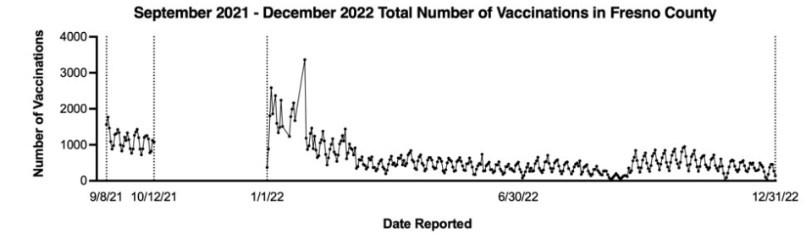
Extra Slides
The overall trend in the number of vaccinations peaked in early 2022 and then settled down with slight fluctuations throughout 2022.
Mapping Inequity in the San Joaquin Valley (SJV): COVID-19 Vaccination Access and Social Vulnerability in Fresno County, CA (2020-2024)​
Notes:
Remove this graph from primary presentation since gap in data!

Slide 19
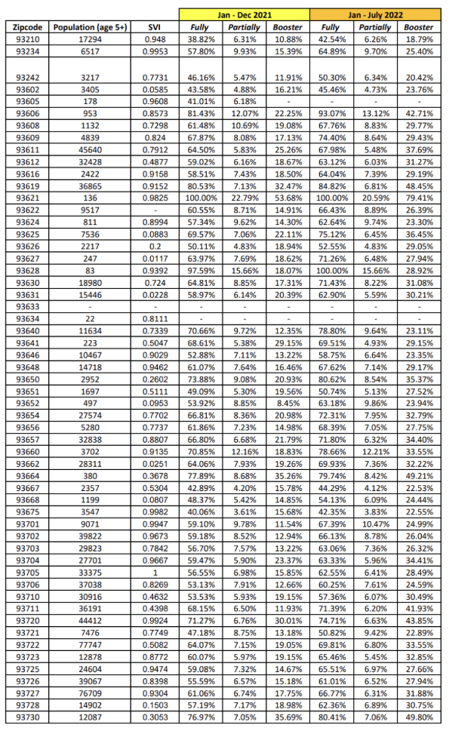
Notes:
For each Fresno County zip code, Table 1.2 lists the portion of the population that is above the age of 5, 2022 CDC SVI, and the percentage of residents who were fully vaccinated, partially vaccinated, or received their booster COVID-19 vaccine between two time periods, Jan – Dec 2021 and Jan – July 2022.

