Slide 1
University of California, Irvine | 2026
Distribution of Type 2 Diabetes and Food Access in Orange County, CA
Lamisa Zaman

Slide 2

Background
  Food insecurity has been associated as a predictor of Type 2 Diabetes (Gucciardi et. al, 2014)
  The geographic distribution of at-risk communities within Orange County (OC), CA remains unclear.

Slide 3

Objectives
Objective 01
Determine distribution of Type 2 Diabetes (T2D) cases within OC County in relation to food deserts
Objective 02
Connect at-risk populations to resources to mitigate diabetes risk

Slide 4
Methodology
A cross-sectional study was conducted using deidentified patient data from the Hurtt Family Health Clinic. Included patients with an A1C ≥ 6.5% and associated T2D ICD codes, from November 2025 to February 2026
Patient residential locations were mapped using QGIS and linked to area-level food access data from the USDA Food Access Research Atlas and the CDC/ATSDR Social Vulnerability Index (SVI).
STUDY SAMPLE
Descriptive statistics assessed geographic distribution and association with food desert classification, vehicle access, poverty level, and social vulnerability.
213
18-65
4
Patients with elevated HbA1c
Age Range
Insurance
Types

Slide 5
Results & Outcomes
  Top 5 zip codes by rate accounted for 38.0% of all patients.
  Correlation between population-adjusted T2D rates and vehicle inaccessibility (r= 0.005) and poverty rate (r= -0.10) did not reach statistical significance.
TOP ZIP CODES BY T2D RATE
ZIP CODE RATE PER 10,000 RESIDENTS (%) LOCATION
92805 12.68 Anaheim
92780 9.86 Tustin
92701 6.57 Santa Ana
92703 5.16 Santa Ana
92705 5.16 Santa Ana

Slide 6
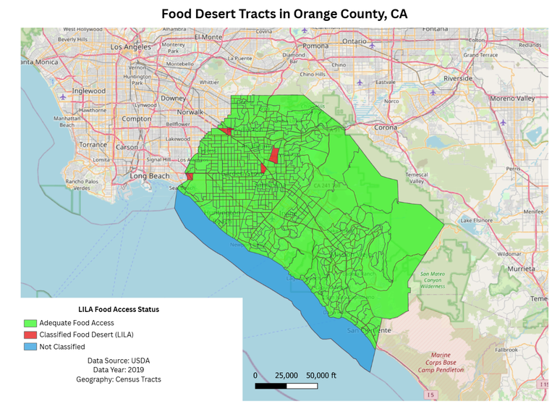
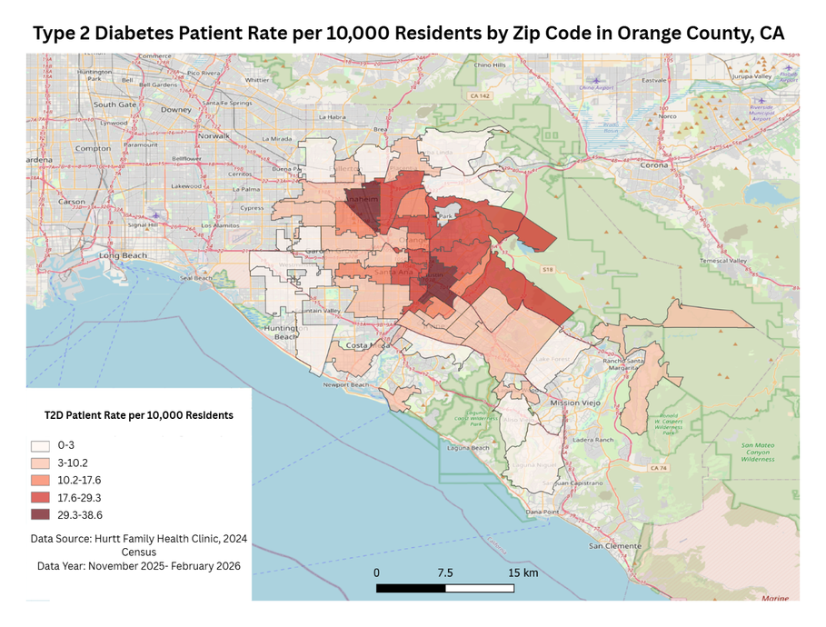
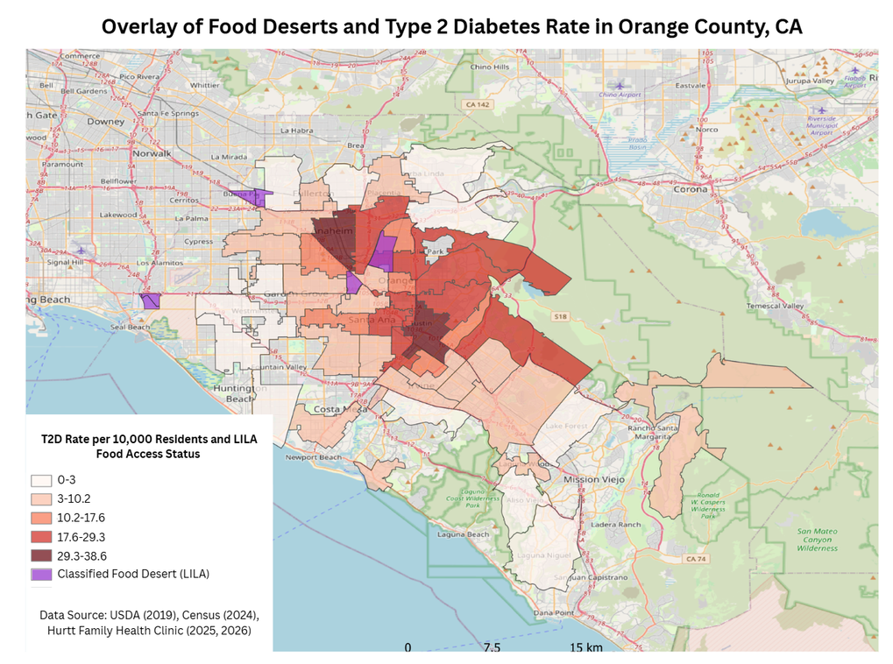
Figure 1: Food Desert Tracts in Orange County, CA
Figure 2: Type 2 Diabetes per 10,000 Residents by Zip Code in Orange County, CA
Results & Outcomes
Figure 3: Overlay of Food Deserts and T2D in Orange County, CA
Visual spatial analysis suggested overlap between high patient density areas and low income low access (LILA) food desert classifications

Slide 7

08
Conclusion & Lessons Learned
Patients with poorly controlled T2D are geographically concentrated in north/central OC, with the highest rates in Anaheim/Tustin/Santa Ana. While statistically significant associations with food desert status could not be confirmed, spatial overlap warrants further investigation.

Slide 8

09
Sustainability
This replicable study utilizes documented data from community clinics, enabling researchers to track population health trends over time and assess the prevalence of diabetes.

Slide 9
Highlighted Sources
Galeana, Beatriz. “Food Inequity in Orange County.” ArcGIS StoryMaps, Esri, 9 Mar. 2024, storymaps.arcgis.com/stories/484b62de0fa541528b8f89615c0c74f4.
Gucciardi, Enza, et al. “The Intersection between Food Insecurity and Diabetes: A Review.” Current Nutrition Reports, vol. 3, no. 4, 2 Oct. 2014, pp. 324–332, www.ncbi.nlm.nih.gov/pmc/articles/PMC4218969/, https://doi.org/10.1007/s13668-014-0104-4.

Slide 10
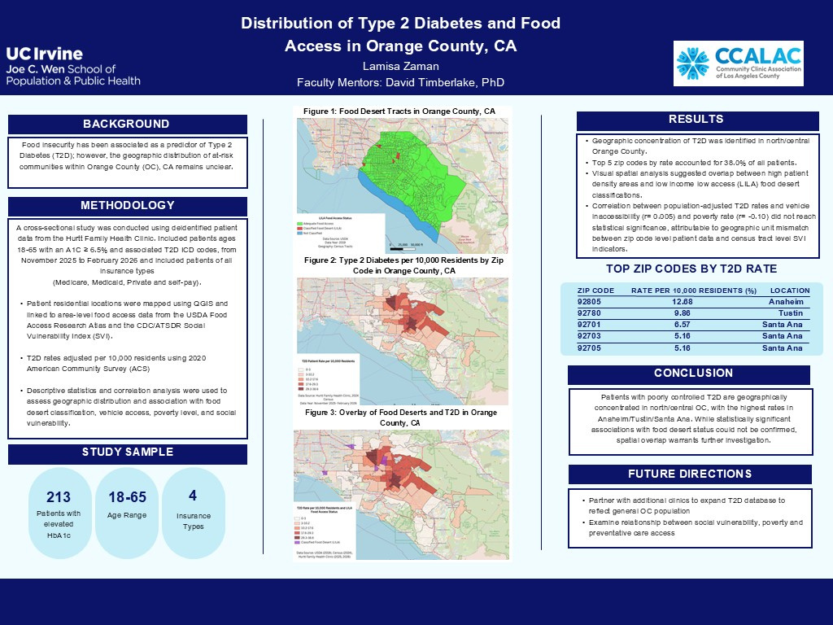
Poster Presentation
Presented at
  UCI Undergraduate Research Opportunities Program (UROP) Research Symposium
  College of Health Sciences, Scholars Day at UCI

