Slide 1
Stitching Futures:
The Impact of Suturing Workshops on Medical Career Interest Among
Students in the Inland Empire
Van Le, Shrey Saretha, and Claire Brammer
California University of Science and Medicine
Inland Empire AHEC

Slide 2
Table of contents
1
2
3
4
5
6
Background
Objectives
Methods
Describe the need for the project and relevant literature
Outline the goals and aims of the project
Describe the project methodology
Findings
Sustainability
Lessons Learned
Discuss relevant data and project outcomes
Discuss plans for sustaining the project
Reflect on key insights and takeaways

Slide 3
Background
Community Need: Many students have limited access to mentorship, clinical exposure, and hands-on medical experiences despite growing demand for a diverse healthcare workforce.
Underrepresentation remains a challenge in medicine
Inland Empire has only 42 primary care physicians per 100,000 residents, well below the 60-80 per 100,000 as recommended by the California Health Care Foundation¹
Early exposure increases interest in healthcare careers, especially among minority students²
Hands-on workshops increase student confidence, interest in medical careers, and sense of belonging in medicine³
→ Opportunity for intervention: Early, hands-on exposure (ie. suturing workshops) may help address educational access gaps and promote healthcare career interest among underserved students in the Inland Empire.

Slide 4
Objectives
Increase access to early medical education opportunities
To increase access to early medical education opportunities through hands-on suturing workshops for students in the Inland Empire
Promote interest in healthcare careers
To increase procedural knowledge and self-confidence exposure through suturing workshops and assess their impact on career interest among students
Increase representation in medicine
To explore the potential of hands-on medical skills workshops as a strategy for increasing access to healthcare career pathways and strengthening the future healthcare workforce in underserved communities.

Slide 5
Methods
Design: Interventional pre/post workshop study with paired item-level analysis
Brief didactic session on sterile technique, wound closure principles, and basic suturing methods, followed by live demonstrations and supervised hands-on suturing practice using suture kits
11 high school students completed anonymous pre-workshop and post-workshop surveys to assess knowledge, confidence, and career interest via Likert-scale responses
Statistical analysis was done using Wilcoxon signed-rank test to compare paired pre- and post-workshop Likert-scale responses. All analysis was completed in R version 4.3.2

Slide 6
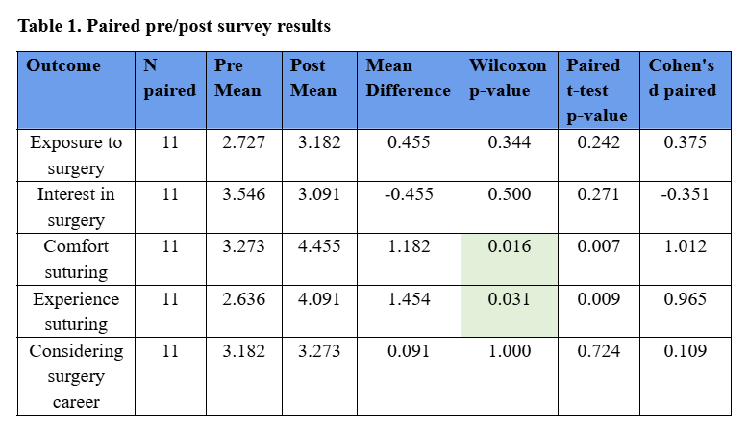
Findings
Comfort suturing significantly improved after the workshop (mean change +1.18 points; Wilcoxon p = 0.0156; Cohen's d = 1.01)
Perceived experience suturing also significantly improved (mean change +1.45 points; Wilcoxon p = 0.0312; Cohen's d = 0.96)
Exposure to surgery, interest in surgery, and consideration of a surgical career did not demonstrate statistically significant pre/post differences.

Slide 7
Sustainability
How can we continue?
Annual or recurring event for local high schools in the IE
Standardized curriculum and materials
Partnerships with local high schools, community organizations, healthcare institutions
Additional clinical skills workshops and healthcare career exploration opportunities
Notes:
Establish the suturing workshop as an annual or recurring event for local high schools in the Inland Empire.
Create a standardized curriculum and teaching materials that can be reused for future workshops.
Recruit medical student volunteers each year to provide instruction and mentorship.
Develop partnerships with local high schools, community organizations, and healthcare institutions to support ongoing implementation.
Seek funding through grants, donations, or institutional support to offset the cost of suturing supplies and educational materials.
Expand the program to include additional clinical skills workshops and healthcare career exploration opportunities.

Slide 8
Lessons Learned
What are limitations of the study?
Lack of long-term follow-up to evaluate whether participants ultimately pursued healthcare careers
Limited participant population
What can change?
Future studies would benefit from larger participant populations, longitudinal follow-up, and expanded mentorship opportunities through partnerships with schools and community organizations.

Slide 9
References
J.W. Vines Medical Society and Foundation. (2026, February 28). To tackle doctor shortage in Inland Empire, J.W. Vines Medical Foundation expands mentorship program [Press release]. https://www.registerguard.com/press-release/story/38101/to-tackle-doctor-shortage-in-inland-empire-j-w-vines-medical-foundation-expands-mentorship-program/
Grumbach, K., & Mendoza, R. (2008). Disparities in Human Resources: Addressing the Lack of Diversity in the Health Professions. Health Affairs, 27(2), 413-422.
Dhahir, A., et al. (2021). The impact of early suturing workshops on pre-medical and undergraduate students’ confidence and interest in surgical careers. Journal of Surgical Education, 78(4), 1221-1227.

Slide 10
Thank you!

